Slide 1

Suicide Prevention Among Working-Aged Adults: The Role of EAPs in Three Countries
Jodi Jacobson Frey, PhD, LCSW-C, CEAP
University of Maryland, School of Social Work, Baltimore, Maryland, US
Kaoru Ichikawa, CEAP, PhD, LCSW, CEO
Resilie Laboratory, Inc., Tokyo, Japan
Paul Jongmin Woo, MD, MPH, PhD
Mental Fitness Institute/Korea Employee Assistance Professionals Association, Korea
International Employee Assistance Professionals Association, Annual Conference
Minneapolis, MN
October 12, 2018

Slide 2
Objectives
Compare working-aged adult suicide risk factors in U.S., Korea and Japan
Understand workplace-based suicide research-based initiatives for working-aged adults
Implement research-based best practices to prevent and respond to workplace suicide

Slide 3
Dr. Jodi Jacobson Frey Outline
Define suicide as a public health crisis
Examine suicide in the workplace
Discuss programs that are addressing the issue
Review the Healthy Men Michigan statewide campaign
Understand the potential for the workplace as a setting for suicide prevention

Slide 4
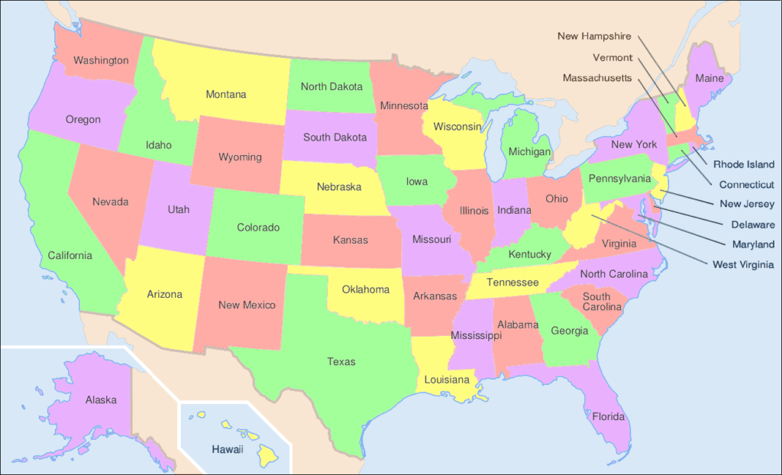
Suicide in the United States

Slide 5



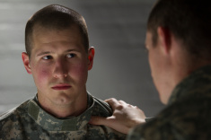
Suicide: A Public Health Problem
Suicide is a significant public health problem
In 2016, there were 44,965 deaths by suicide in the U.S.
Suicide is the 10th leading cause of death
For every suicide death, there are an estimated 25 suicide attempts
On average, there are 123 suicides per day
Average of 1 person every 11.7 minutes killed themselves

Slide 6
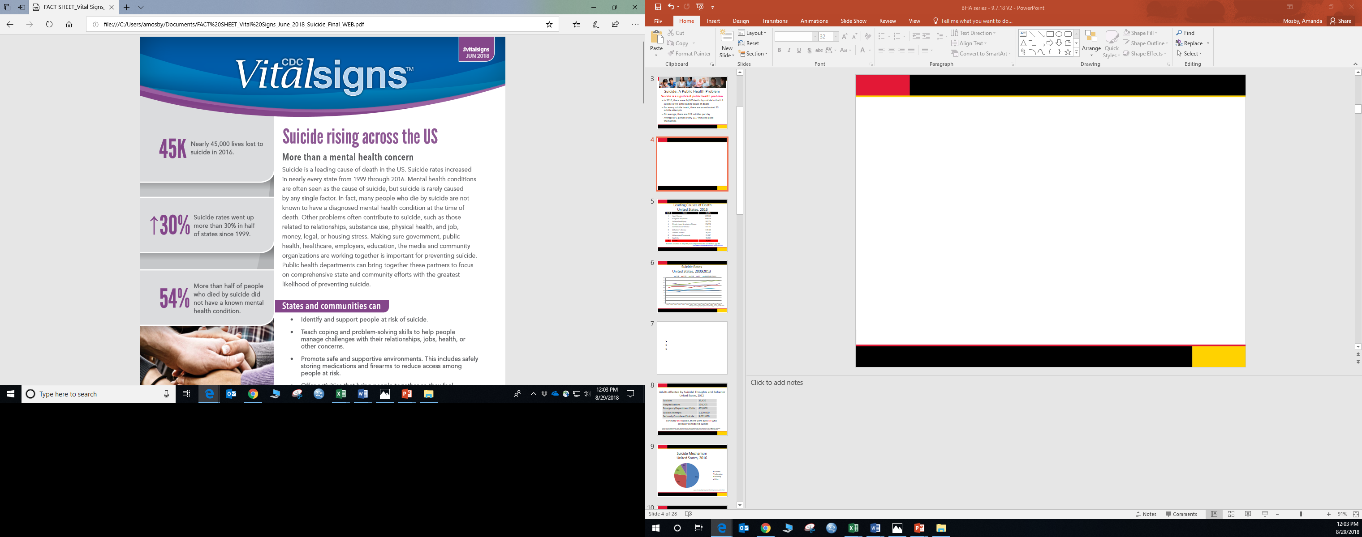
https://www.cdc.gov/vitalsigns/suicide/index.html

Slide 7
Leading Causes of Death United States, 2016
Rank | Cause | Deaths
1 | Heart Disease | 635,260
2 | Malignant Neoplasms | 598,038
3 | Unintentional Injury | 161,374
4 | Chronic Lower Respiratory Disease | 154,596
5 | Cerebrovascular Disease | 142.142
6 | Alzheimer’s Disease | 116,103
7 | Diabetes Mellitus | 80,058
8 | Influenza and Pneumonia | 51,537
9 | Nephritis | 50,046
10 | Suicide | 44,965
Suicides resulted in 804,194 years of potential life lost before age 65
http://www.cdc.gov/injury/wisqars/leading_causes_death.html

Slide 8
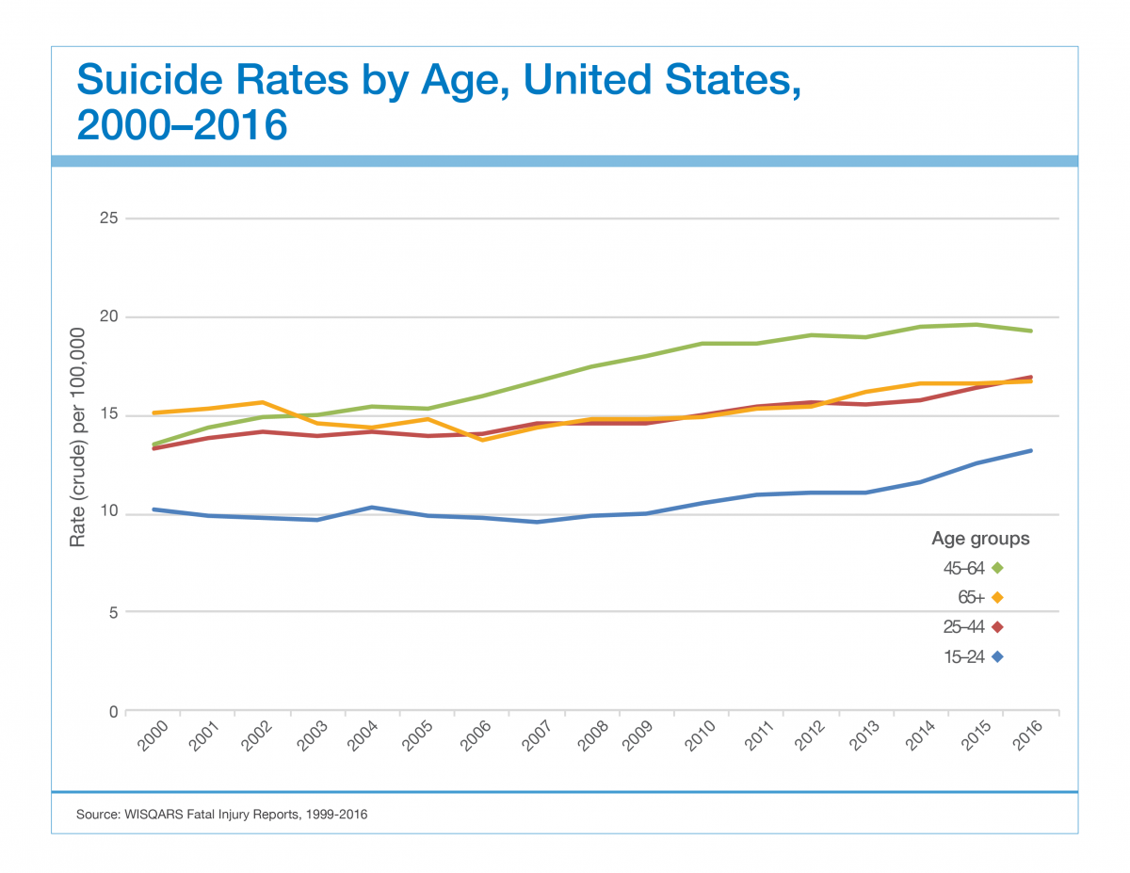
Suicide Rates by Age, United States, 2000-2016

Slide 9






Suicide and Middle Adulthood
Suicide among middle-aged adults (35-64 years)
Fifth leading cause of death
Largest proportion of suicides (54%)
Suicide rate increased 29% since 2000
www.cdc.gov/injury/wisqars/leading_causes_death.html
Sullivan et al. MMWR 62(17);321-325
Sullivan et al. MMWR 64(8):201-205

Slide 10
Suicide and the Workplace
“The workplace is the last crucible of sustained human contact for many of the 30,000* people who kill themselves each year in the United States. A co-worker’s suicide has a deep, disturbing impact on work mates. For managers, such tragedies pose challenges no one covered in management school.”
- Sue Shellenbarger, Wall Street Journal
*In 2016, nearly 45,000 people died by suicide

Slide 11

Why the Workplace?
Another important piece of community-wide prevention
Financial impact to businesses
Place of “belonging”
Place of “effectiveness”
Co-workers often have more face time than family

Slide 12
Suicide Prevention Efforts in the United States

Slide 13

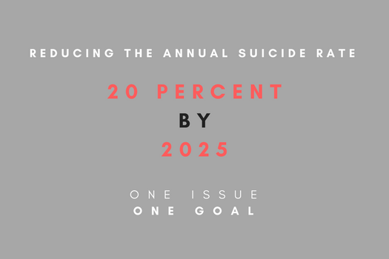
National Strategy for Suicide Prevention
Championing suicide prevention as a national priority;
Catalyzing efforts to implement high priority objectives of the NSSP; and
Cultivating the resources needed to sustain progress

Slide 14
Research Team
Accomplishments and current initiatives include:
Changing the public conversation around suicide and suicide prevention
Transforming health care delivery for individuals at highest risk for suicide
Increasing the quality, timeliness, and usefulness of surveillance data on suicidal behaviors
Advancing suicide prevention for specific populations and in specific settings

Slide 15
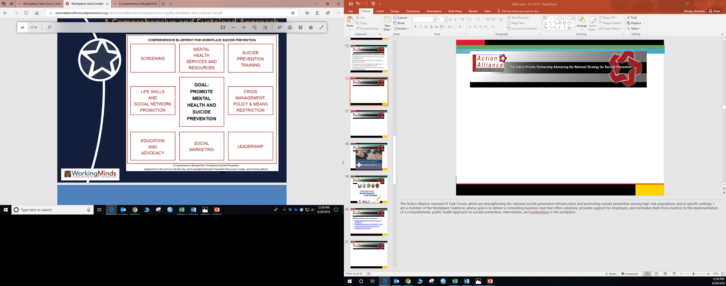
Research Team

Slide 16
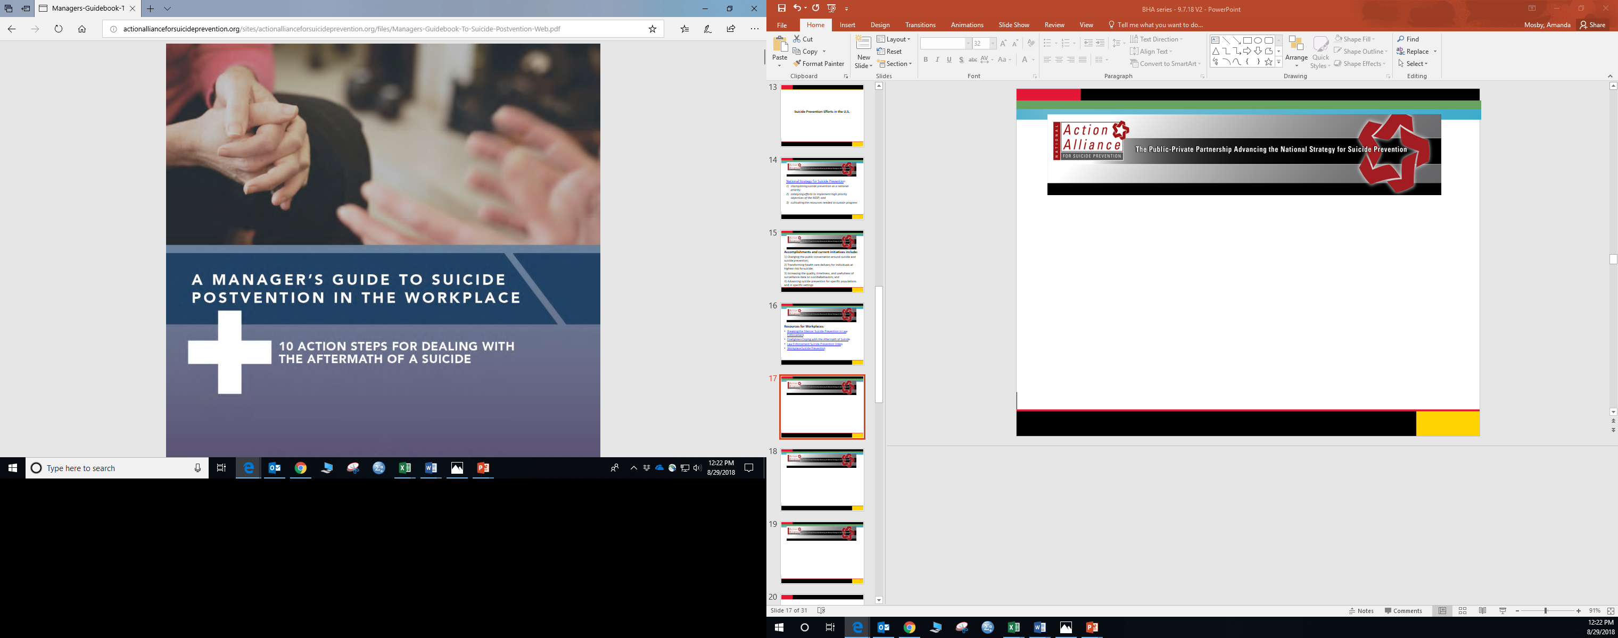
Research Team

Slide 17
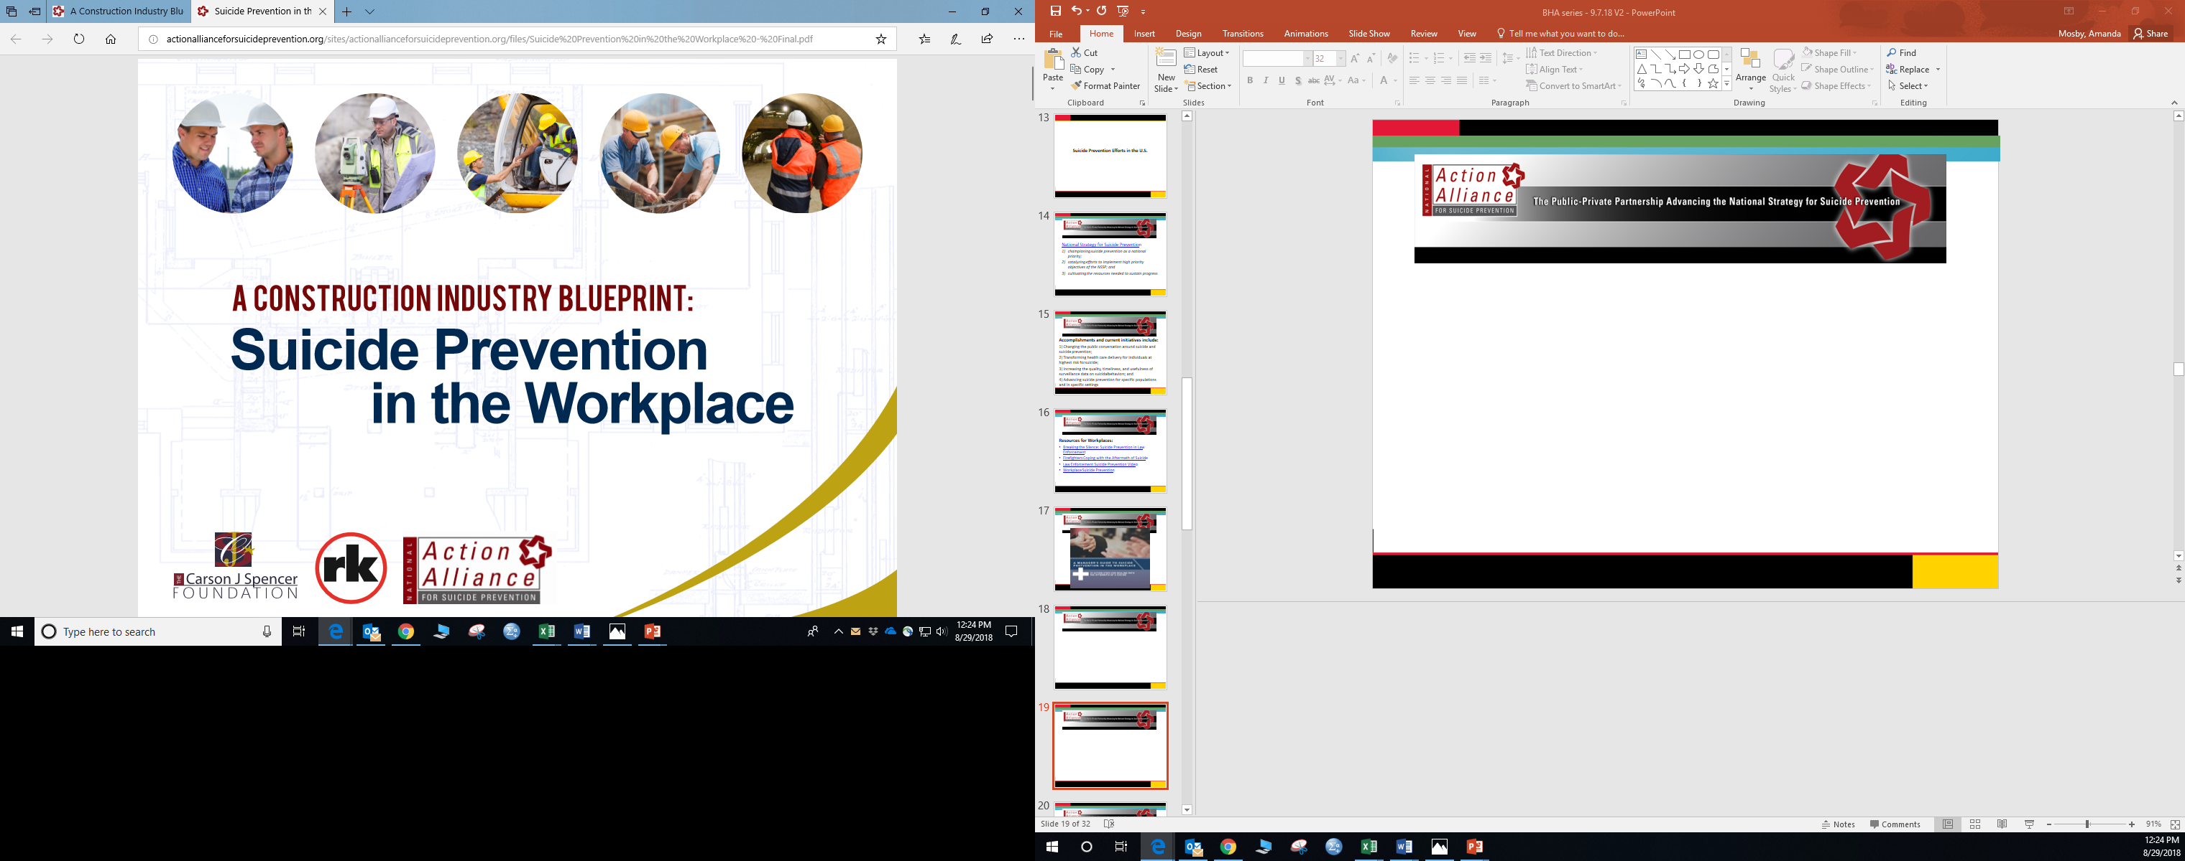
Research Team

Slide 18
Research Team
Additional Resources for Workplaces:
Breaking the Silence: Suicide Prevention in Law Enforcement
Firefighters Coping with the Aftermath of Suicide
Law Enforcement Suicide Prevention Video
Workplace Suicide Prevention

Slide 19


Online Screening and Early Intervention to Prevent Suicide among Working Aged Men
This research is supported by the Cooperative Agreement Number, 1 U01 CE002661-01, funded by the Centers for Disease Control and Prevention. Its contents are solely the responsibility of the authors and do not necessarily represent the official views of the Centers for Disease Control and Prevention or the Department of Health and Human Services.

Slide 20
Suicide and Working-Aged Men
“Although men in the middle years (MIMY)—that is, men 35–64 years of age—represent 19 percent of the population of the United States, they account for 40 percent of the suicides in this country. The number of men in this age group and their relative representation in the U.S. population are both increasing. If the suicide rate among men ages 35–64 is not reduced, both the number of men in the middle years who die by suicide and their contribution to the overall suicide rate in the United States will continue to increase.”
Suicide Prevention Resource Center (2016).
Preventing suicide among men in the middle years:
Recommendations for suicide prevention programs.
Waltham, MA, Education Development Center, Inc. p. 3

Slide 21
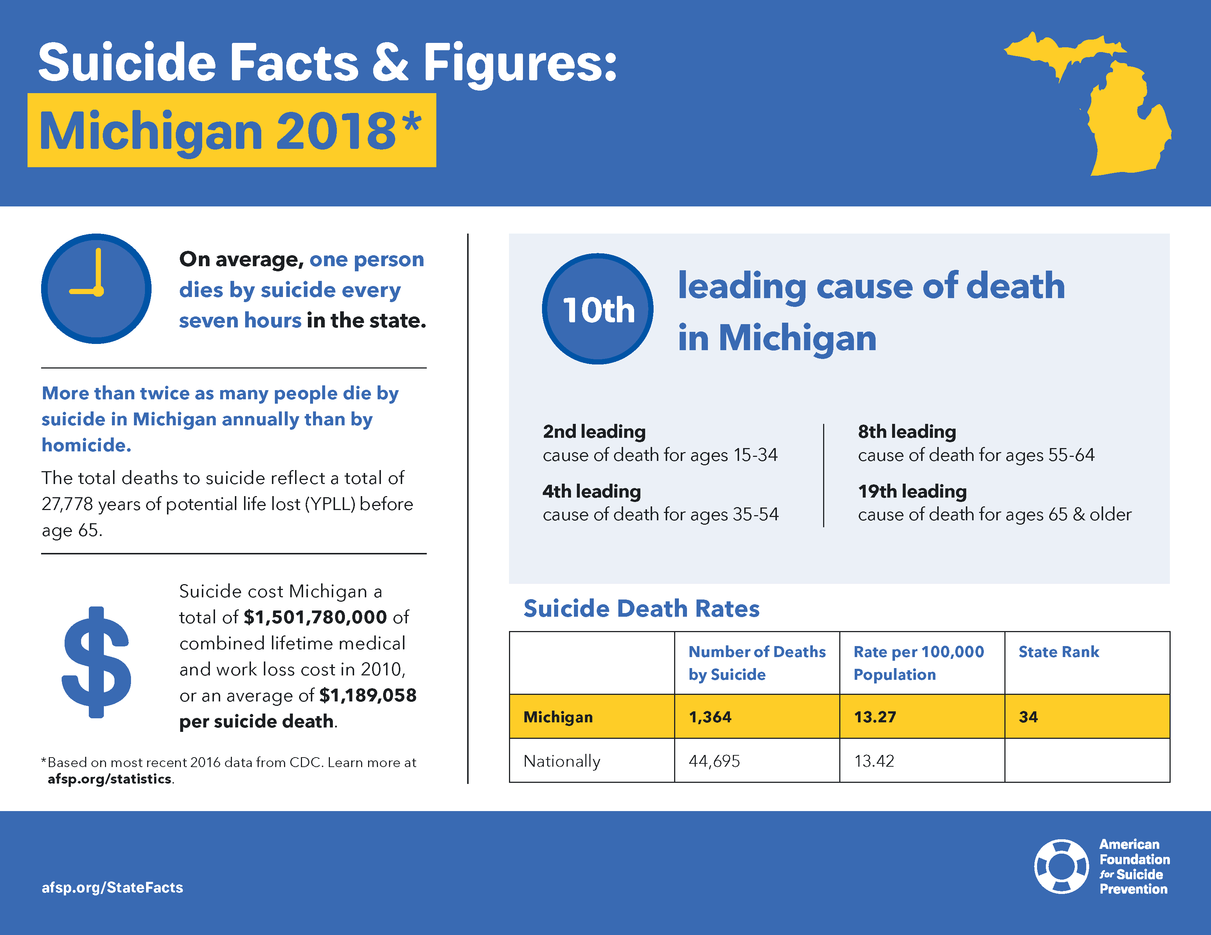

Slide 22
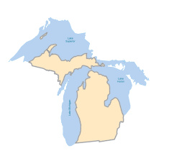

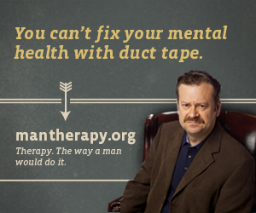

Healthy Men Michigan
Comprehensive online screening and referral intervention, integrating two existing, and promising, online programs
Screening for Mental Health
Man Therapy

Slide 23
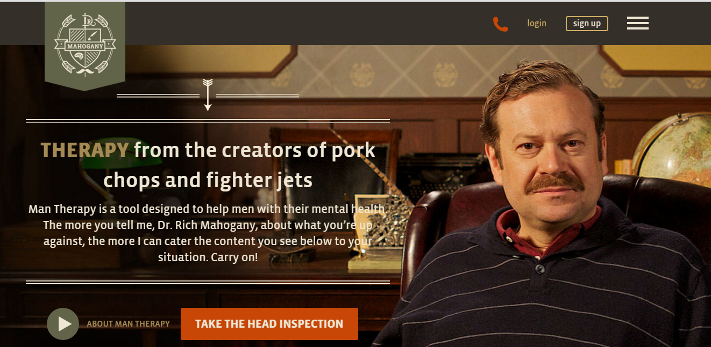
MAN THERAPY
Therapy. The Way A Man Does It

Slide 24
Healthy Men Michigan: Research Study Aims
Aim 1: To test the additive effect of MT when offered in combination with SMH, as compared to SMH alone, on the following:
Primary Outcomes: suicide behavior (i.e. suicide attempts and suicide preparatory acts) and ideation, depression and anger;
Secondary Outcomes: attitudes toward seeking professional mental health services; help-seeking behavior (i.e. utilization of online services and community referral resources); suicide risk factors (i.e. drug and alcohol abuse, relationship conflicts, financial problems, and interpersonal needs); and the protective factor of social support.
Aim 2: To assess and compare barriers and facilitators to men seeking suicide prevention services.

Slide 25
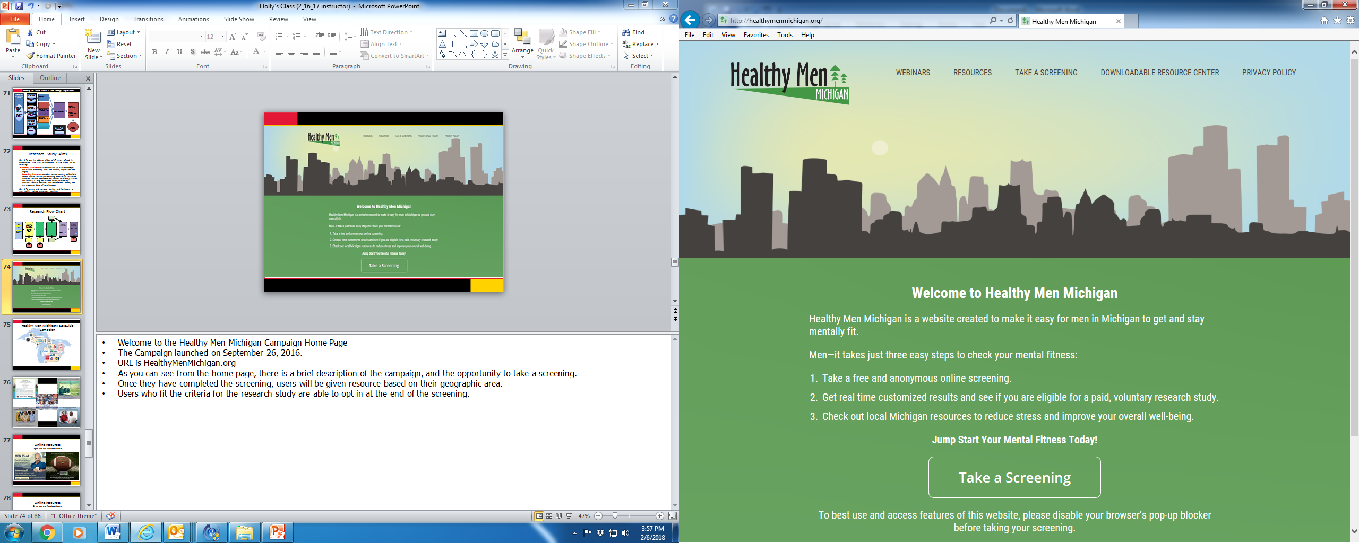

Slide 26




























Healthy Men Michigan: Statewide Campaign

Slide 27
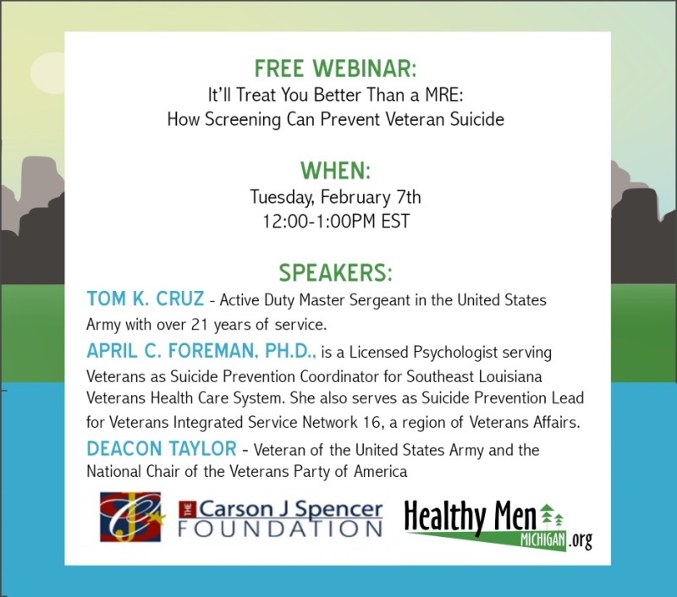
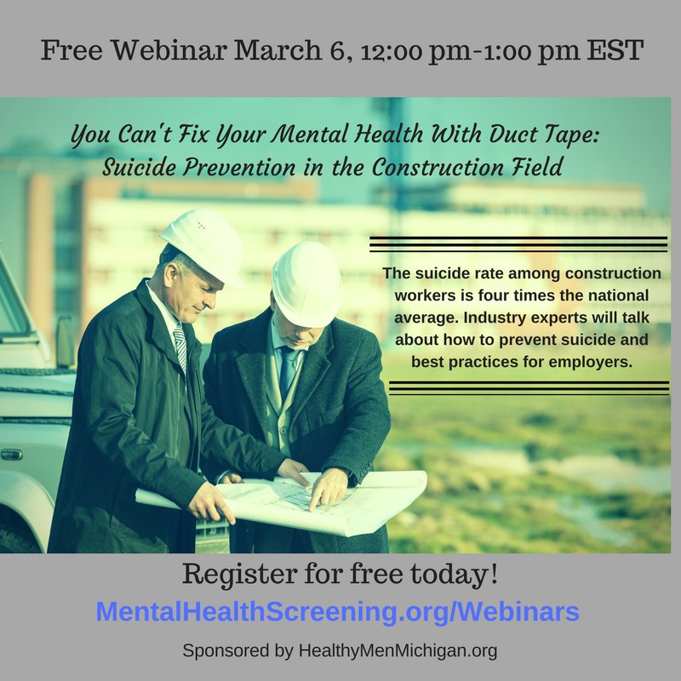

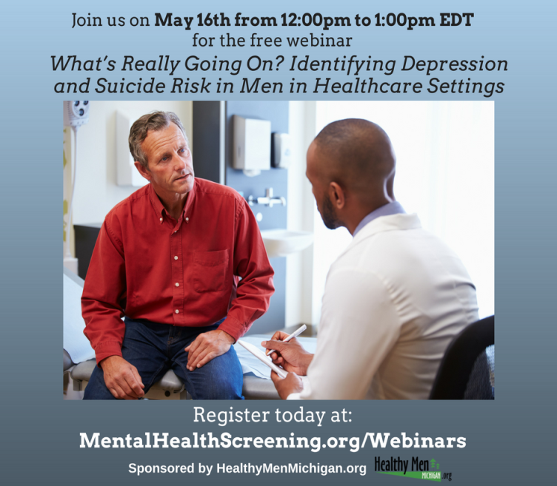

Slide 28
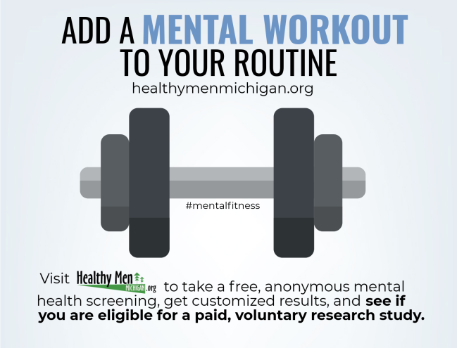
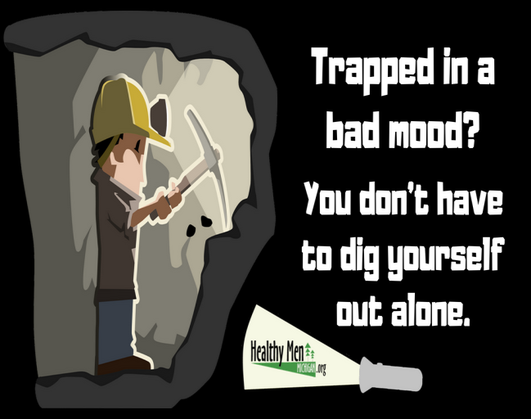
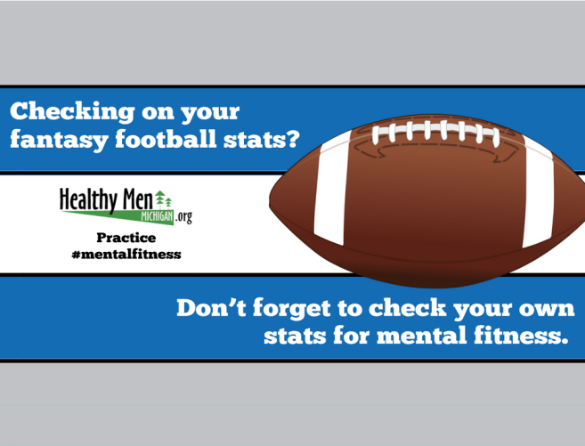
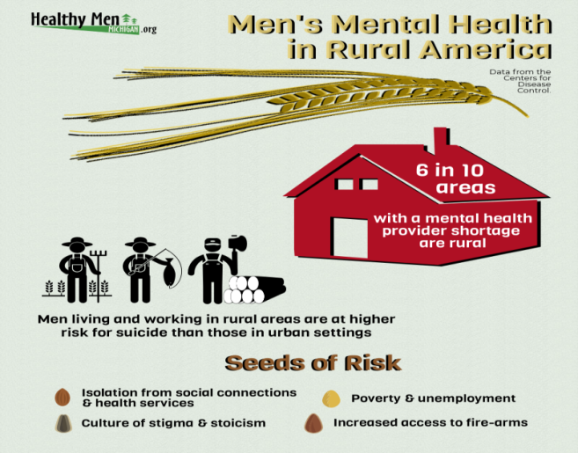
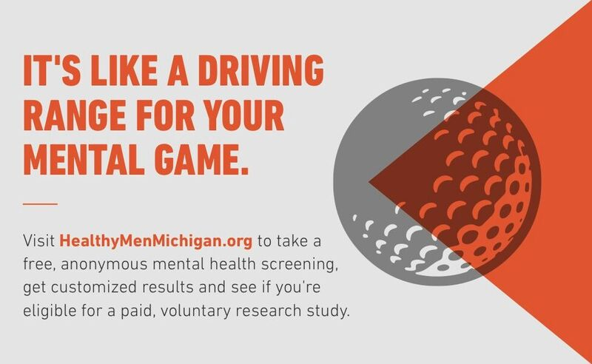

Slide 29
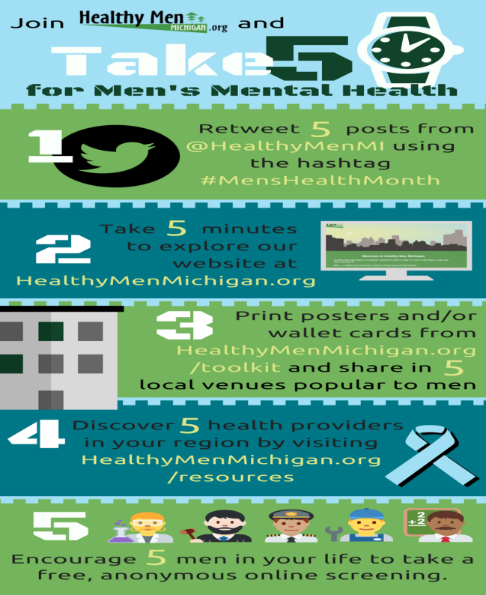

Slide 30

Men in Michigan Are Taking Action
Here’s How You Can Help
1. Social Media and Word of Mouth are how men are hearing about the campaign
Send promotional emails and social media posts to members of your community by using the ToolKit
http://www.ssw.umaryland.edu/healthymenmichigan/downloadable-resource-center/
2. Michigan is a big state with lots of different areas to cover!
Help spread the word with free promotional materials while you are out across Michigan http://www.ssw.umaryland.edu/healthymenmichigan/downloadable-resource-center/
3. The workplace is another great place to promote the campaign! Add a link to www.HealthyMenMichigan.org on your organization’s website and newsletter
4. Send a link to www.HealthyMenMichigan.org to your employees/colleagues
5. Connect with us and stay up to date on the Healthy Men Michigan campaign
Email us at healthymenmichigan@gmail.com to sign up for the eNewsletter
Spread the word about men’s mental fitness in Michigan!

Slide 31
Healthy Men Michigan: What Have We Learned So Far?
Almost 15% of the men in our study learned about Healthy Men Michigan from their employer
The most common way men are connecting to the online screening is through social media
More than 2,800 men who live in Michigan between the ages of 25-64 have completed the screening.
Over 60% screened at risk for depression
Over 40% of these men screened at risk for suicide
Notes:
While we are not able to report research study results at this time, the research team has collected data to show that the Healthy Men Michigan campaign is having a positive effect for those who have taken the online screening.
Because of the large net we cast to cultivate partners throughout the state and the ongoing promotion activities of the team, more than 6,100 individuals visited the HealthyMenMichigan.org website and completed the project’s screening.
To date we have screened more than 2,800 men who live in Michigan and are between the ages of 25-64. Of those men, more than 60% have screened positive for moderate or high levels of depression. Among the men screening positive for depression, over 40% also screened positive for suicide. Additionally, more than 10% of men screened positive for suicide, but did not screen positive for depression. More than 380 men have enrolled in the study. Our goal is to recruit up to 500 men by January 31, 2019.
We have good representation across all age groups: 28% (25-34), 25% (35-44), 24% (45-54) and 23% (55-64)
Our sample is primarily white (84%; 75% of men in Michigan are White according to the U.S. Census). 6% are Black/African American, and 2% are Hispanic 2% are Multiracial.
We have representation from all regions in the state, including rural and urban areas.
Referrals are coming from many areas, not just mental health and behavioral health settings.
Men are learning about Healthy Men Michigan most commonly through social media (49%). Other sources include online search (19%), article/blogpost (16%), and word of mouth (9%).
Men are hearing about the website from their home/neighborhood (25%), mental health or behavioral health organization (18%), employment setting (14%) and community organizations (12%).
I am very encouraged that men are visiting HealthyMenMichigan.org and taking the first step to get information and support. Since our data shows that more than 40% of those visiting the website are at risk for suicide, I’m glad that we can provide a free resource to men who might not otherwise seek help.
Men are writing emails and messages to us about how the Healthy Men Michigan and Man Therapy websites have served as a great resource for helping with their symptoms of depression and suicide. They report the websites are a place where men can get information/education, immediate support and trusted referral resources. Many men are reporting that they did not think they needed help before taking the screening and getting results.

Slide 32

Connect with Healthy Men Michigan!
https://www.facebook.com/HealthyMenMichigan/
https://twitter.com/HealthyMenMI
http://healthymenmichigan.org/

Slide 33
Dr. Kaoru Ichikawa Outline
Characteristics of suicide in Japan – Statistics and analysis
Development of suicide prevention strategy
Center for Suicide Prevention
Work Style Reform Act
Critical Incident Care by EAP – Japanese cultural adaptation

Slide 34
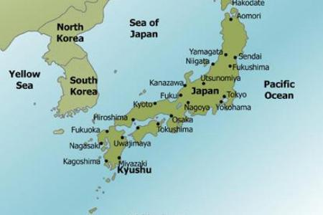
Suicide in Japan

Slide 35
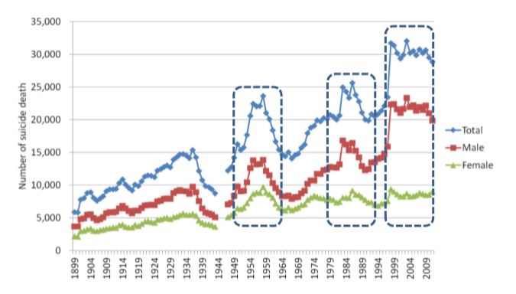
Number of Suicides in Japan (Historical perspective 1899-2011)
1991 Long Recession
(1991 – 2001)

Slide 36
Number of Suicides in Japan (Recent trend 2007-2017)
2007 Total Suicide 33,093
Number of suicide death
2011 Tsunami/Earthquake
2017 Total 21,321
Salaried Workers 6,432

Slide 37
Number of Suicides: Salaried Employees (Recent trend 2008-2017)
9,157 (2009)
30% reduction
6,432 (2017)

Slide 38
Major Reasons of Suicide of Employees in Japan
(N= 5364)
(N= 1361)
Source: Japan National Police (2015 data, published in 2016)

Slide 39
Characteristics of Suicides in Japan from Statistics
Suicide rates increased sharply in 1998, particularly among middle aged-men.
Health (mainly mental health dx) and work-related problems are the top reasons of suicide among the employed population.
Suicide rates of middle-aged men who are unemployed have been extremely high.
Suicide rates of younger people have been increasing, while suicide rates of older people have been gradually decreasing.

Slide 40
Development of Suicide Prevention Strategy
The First Phase 1998
2000. Set a numerical target as part of “Healthy Japan 21st”
The Second Phase 2005
2005 July. Upper House resolution for comprehensive strategy against suicide
2006. Foundation of the Center for Suicide Prevention (CSP) in NIMH, NCNP
2001. MHLW budget for suicide prevention
2002. Report by Suicide Prevention Council
2004. Introduction of Policy for Depression
2005 Sep. Suicide Prevention Liaison Committee (SPLC) established
2005. Dec. Report on National Suicide Prevention Strategy by SPLC
Basic Act for Suicide Prevention passed
2007. General Principles for Suicide Prevention Policy (GPSP) established
2008. Preparation of Special Fund for Local government
2012. Revision of GPSP
The Third Phase 2006

Slide 41
Center for Suicide Prevention
Mission: Support comprehensive suicide prevention activities of the central government from the viewpoint of mental health.
Policy Proposal
Information
Networks creation
Expert development
Research

Slide 42
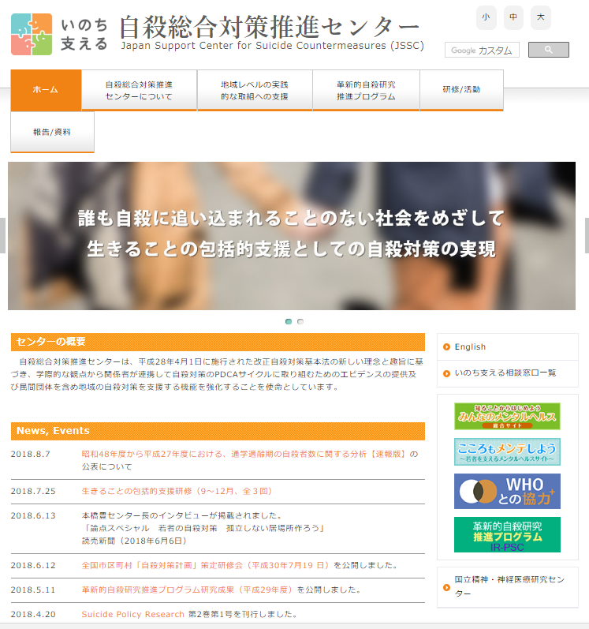
Japan Support Center for Suicide Countermeasures (JSSC)
https://jssc.ncnp.go.jp/index.php

Slide 43
How about Workplace Suicide Prevention and Countermeasures?

Slide 44

National Level Countermeasures for orkplace Mental Health
Research and Policy
MH Prevention Center
Online Education
Org
Level
Mental Health Screening
（Secondary Prevention）
Team Care
（Tertiary Prevention）
Mental Health Self Care
（Primary Prevention）
Stress Check System
Follow Up interviews
Legal Requirements
Care by Managers
Training, Wellness Promotion
Monitoring Overwork time
Workplace Bullying Index
Education to promote self care
Guide Book how to reintegrate employee from the mental health related leaves.
Rework session and assistance provide Vocational centers
Care by OHR/external EAP
Individual level

Slide 45
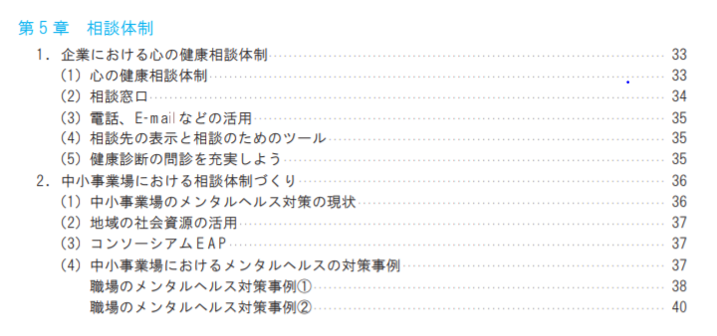

Workplace Suicide Prevention and Countermeasures– A Manual for Prevention of Workers’ Suicide - (MHLW)
P37
“Consortium EAP”
(Solution for small to mid size corporation)

Slide 46
Work Style Reform Act (2018)
Trigger: Suicide of 23 year old, Tokyo University graduate in an Advertisement Agency - Miss Matsuri Takahashi from overwork and workplace bullying / morale harassment (2016.12)
Key components of Work Style Reform LAW
45 hours / month
360 hours / year
Work Style Reform
Over-time work LIMIT
enforcement
Flex Time
Stronger Occupational Health Physician Function
10 hour intervals before the next day work
Diversity & Inclusion
Healthy Corporation Accreditation
Harassment-Free Policy

Slide 47
Critical Incident Care after Suicide by EAP Japanese Cultural Adaptation Multi-Systemic Resiliency Approach + Mental Rescue
“Multi- Systemic Resiliency”
Approach
“Mental Rescue” approach
Japanese Military
Based on empirical data
Utilized for 200 suicide postvention among Japanese self defense force
Robert Intveld (Nishikawa translate)
EAPA endorsed methods

Slide 48
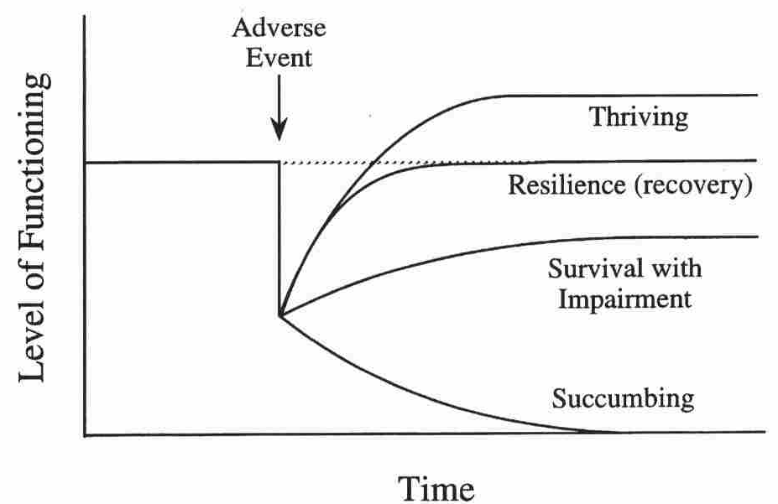
Multi-System Resiliency Approach
Thrive
Crisis Incidents
Resilience
Work Space
Reactions
Survive

Slide 49
MRSA
Mental Rescue
Org
EE
Flight
Fight
Freeze
Self-accusing
Anxiety
Helplessness
EAP
Critical
Incident
Response
Depression
Resignation
Responder
First Shock
Second Shock
Fatigue
Doctors
& Nurses
EAP

Slide 50



EAP - CIR Specialist Training - Japanese Way
“KATA” – How to empathize to basic human emotions
Utilization of Folklore, Japanese Archetype
Shaping → “100 times catching balls”, “100 times swinging bats”
Drill – Roleplaying practice until you master “KATAs”
Video-taping -> self reflection / supervision
Test – Roleplaying

Slide 51
EAP - CIR Specialist Training – Japanese Way
 | Theme | Content | Learning Objectives
Day1 | Product knowledge and individual counselling skill | Crisis peer support, EAP Crisis intervention, Manual, Tool, homework Bank case | Able to provide individual counselling based on, Able to explain WCM to customers
Day2 | Intervention Strategy | Present strategy | Able to work in team when sudden request comes. Able to assess the emotion of the customers based on limited information
Day3 | Communicate to HR Director and Managers | Team vs Individual management consultation to HR | Able to explain to HR and managers about strategy based on the hearing conducted, Notice the managers' concern
Day4 | Psychological Education | Demonstrate psychological education talk | Able to report the WCM result and able to avoid falling from cliff. Able to create reporting.
Day5 | Group Meeting / Care | Conduct group session | Experience group care
Test | Check out | Meet with SV | Able to conduct 15 minutes initial assessment

Slide 52
Summary
Characteristics of suicide in Japan – Statistics and analysis
Development of suicide prevention strategy
Center for Suicide Prevention
Work Style Reform Act
Critical Incident Care by EAP – Japanese cultural adaptation

Slide 53
Dr. Paul Jongmin Woo Outline
Recent trend of national statistics on suicide in Korea
Working-aged adult suicide trends and risk factors
National suicide prevention strategy in Korea
Workplace-based suicide initiatives for workers
Research-based best practices to prevent and respond to workplace suicide: Experiences of KEAPA

Slide 54
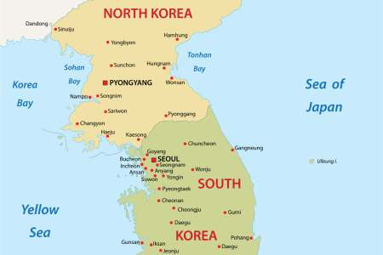
Suicide in Korea

Slide 55
Suicide Prevention Among Working-Aged Adults: The Role of EAPs
Paul Jongmin Woo, MD, MPH, PhD
Korea EAP Association

Slide 56
Outline
Recent trend of national statistics on suicide in Korea
Working-aged adult suicide trends and risk factors
National suicide prevention strategy in Korea
Workplace-based suicide initiatives for workers
Research-based best practices to prevent and respond to workplace suicide: Experiences of KEAPA

Slide 57
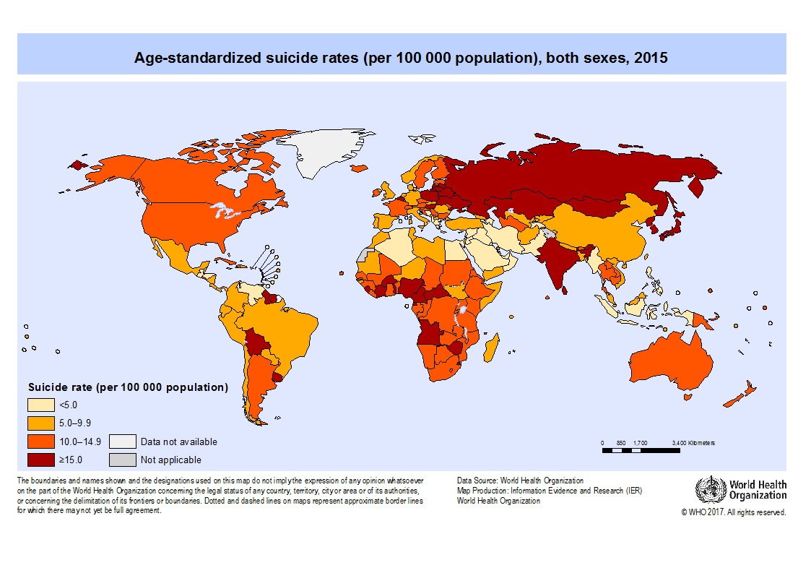
Suicide rates map
WWW.WHO.INT 2007

Slide 58
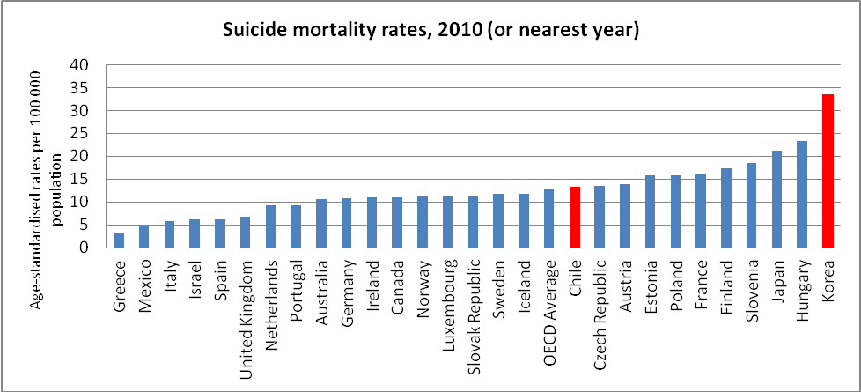
Suicide among OECD countries
South Korea has had the highest suicide rate among the Organisation for Economic Co-operation and Development (OECD) countries for 13 consecutive years.

Slide 59
Suicide rate in Korea
!
13,092 people suicide in 2017
!
An average of 35 people per day
Cause of death among 10s, 20s, 30s : 1st
among 40s, 50s : 2nd
The number of deaths in the 40-50s ranked first
Suicide rate : the highest among the elderly

Slide 60
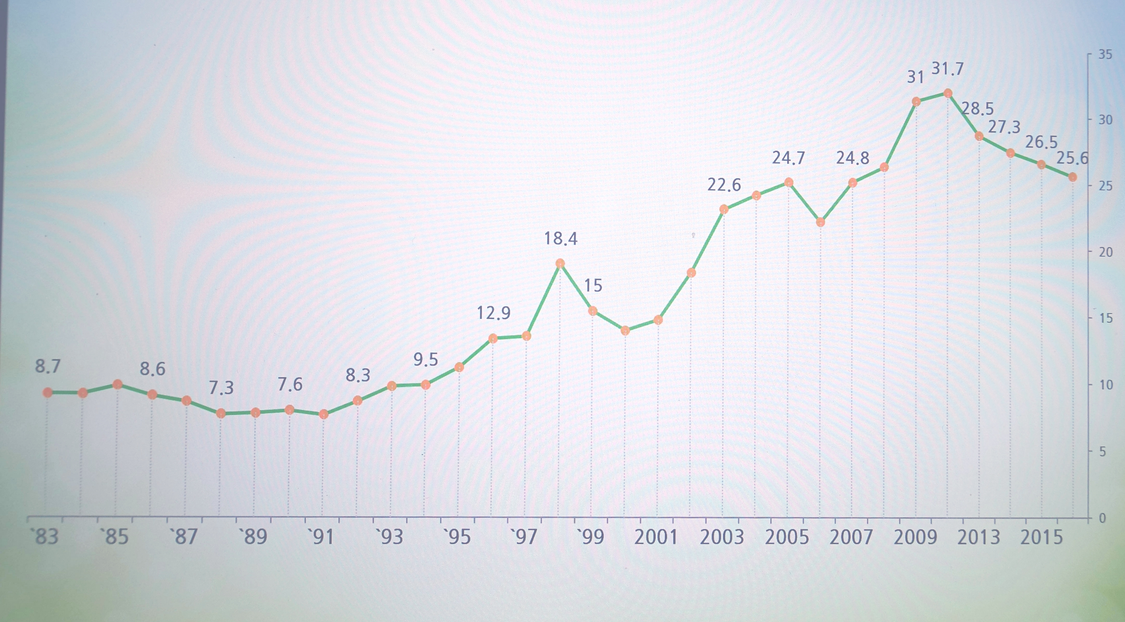
Recent trend of decreasing since 2011
The rate has been decreasing slightly since 2011. 13,092 people Suicide in 2016, down 17.7% from 15,906 in 2011.

Slide 61
Suicide rate (x10⁶)
The suicide rate according to gender was overall higher in males than in females. The suicide rate of males was higher by a factor of approximately 2.4. (c.f. approx. 5 in the U.S)
Notes:
Statistics Korea, 2010. Death Statistics in 2009. Statistics Korea, Daejeon.
analyzing the raw data on causes of death provided annually by Statistics Korea (Statistics Korea, 2017), and the trends in suicide according to motive were evaluated by referring to internal data from the National Police Agency
The suicide rate according to gender in 2016 was established at 36.2% for males and 15.0% for - 2 - females, such that the suicide rate of males was higher by a factor of approximately 2.4. The suicide rate according to gender was thus overall higher in males than in females.

Slide 62
Suicide rate by age group
[Vital statistics]
Notes:
[Source: National Statistical Office, 2012-2016 Cause of Death Statistics]
Although the suicide rate according to each age group demonstrates a decreasing trend overall, only the rates for teens and individuals in their 20's have narrowly increased, which suggests that future trends must be observed and appropriate inte
Although the number of teen suicides is not as high as adult suicides, this rate cannot be disregarded. Additionally, considering that the adolescent stage is an important phase in development, the implications of such a rate are quite significant. In the case of the suicide rate among the elderly, the declining tendency suggests that policies implemented that aimed to achieve suicide prevention are starting to show results. Nevertheless, the suicide rate among the elderly is still significantly high in comparison with that of other countries, indicating that policies for elderly subjects must be further enforced. This implies that effective projects among existing polices for prevention of elderly suicides must be continued and, more importantly, a rather radical resolution method must also be prepared.rventions made.

Slide 63
Number of suicide by age group (2016)

Slide 64
Specifics
Method of suicide
Hanging 51.6% ≫ Jumping from height 14.6% ≥ gas intoxication 14.0% (2016)
hanging accounts for the highest proportion at approximately 50% each year.
Spring peak
March-May ≥ Sep ≫ Jan
Cause
Psychiatric disorders is the most prevalent cause.

Slide 65
Suicidal Employees in Korea
Woo J-M. Development of Mental Health Promotion Service Model at Workplace. 2013.

Slide 66
Emotional Labor: Service and Sales
Notes:
the occupation group with the highest number of deaths by suicide in 2016 was workers in service and sales (10.5%), followed by workers engaged in simple labor (6.3%), and fishery workers, experts, and associated workers (5.2%). Workers in service and sales accounted for the highest percentage since 2012, and while workers engaged in simple labor accounted for the 4th highest in 2012, that proportion gradually increased, resulting in the 2nd highest proportion after 2014. The proportion of fishery workers decreased after 2012, but increased to the 3rd highest after 2014. The proportion of experts and associated workers gradually increased from 2012 and recorded the 3rd highest proportion in 2016. Although the proportion accounted for by workers engaged in simple labor as well as by experts and associated workers is quite small, its proportion is increasing each year, suggesting that the corresponding trend must be further monitored

Slide 67
Unemployment and suicide
Massive lay-off in shipbuilding industry
→ Suicide ↑ 53 (2015) → 90 (2016)
Designating “Employment Crisis Region” → Educating OHN & Providing counselling services to prevent suicide and occupational trauma

Slide 68
Low Utilization Rate of Mental Health Services
-National Mental Health Survey(2006)
Psychiatric Disorder | People who answered | Patients among answerer | People who used services | Rate (%)
Alcohol use disorder | 5,872 | 413 | 23 | 5.6
Depressive disorder (MDD+Dysthymic disorder) | 5,872 | 127 | 34 | 26.8
Psychotic disorder | 5,872 | 33 | 10 | 30.3
Anxiety disorder | 5,872 | 373 | 48 | 12.9
Somatoform disorder | 5,872 | 30 | 8 | 26.7
Whole psychiatric disorder | 5,872 | 1,146 | 102 | 8.9
Notes:
This table shows each psychiatric disorder and utilization rate of mental health services.
Depressive disorder includes MDD and dysthymic disorder.
Look at the line of depressive disorder and the bottom line, whole psychiatric disorder.

Slide 69
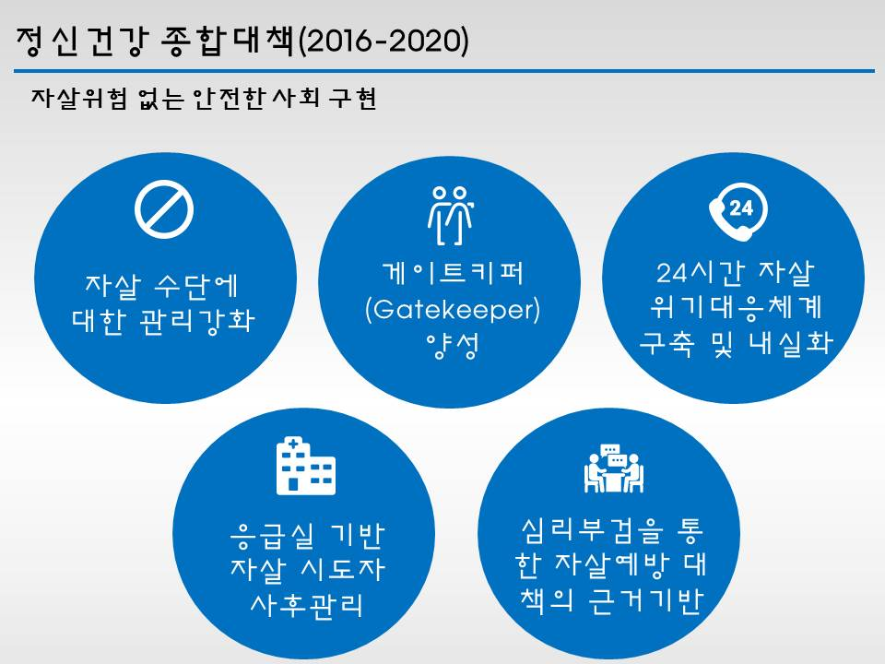
Suicide prevention was included in the government’s 100 national major agenda
Building a safe society without risk of suicide
Korean government announced more comprehensive Suicide countermeasures (2016 – 2020)
Enhanced management of
suicide measures
Gatekeeper
24 Hour Crisis Response System
ER based Postvention Program
Prevention of suicide through
psychological autopsy

Slide 70
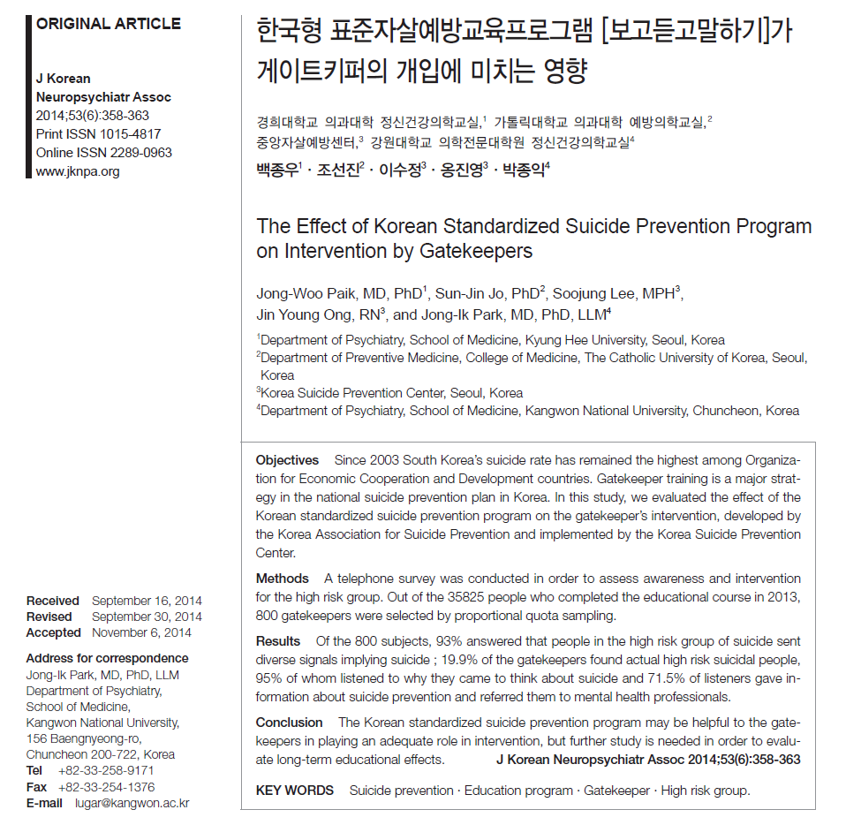

Slide 71
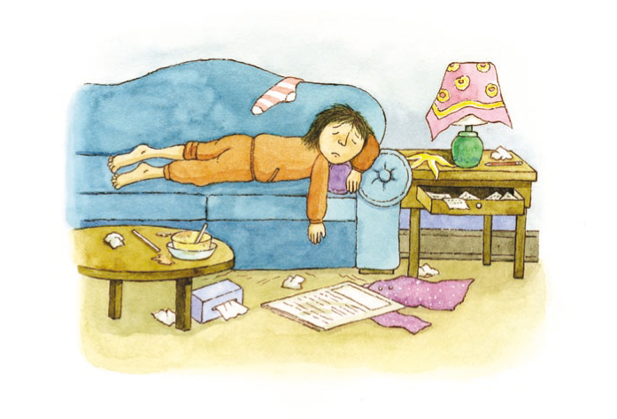

Slide 72
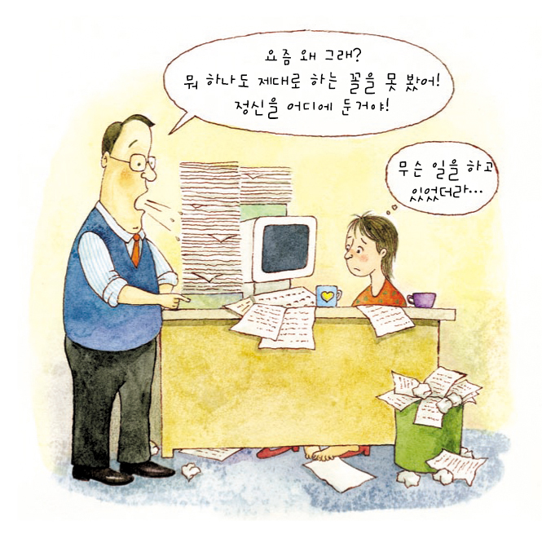

Slide 73
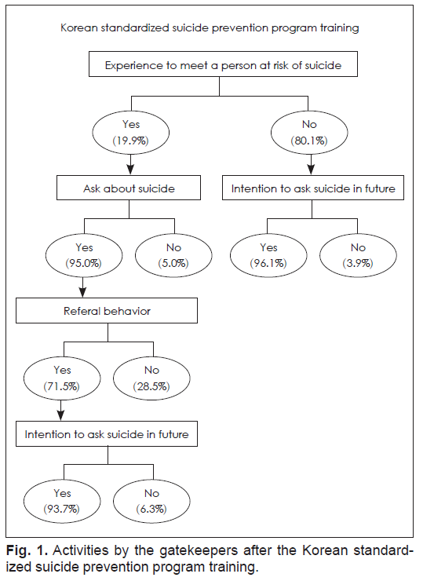
Gatekeeper training
The KASP developed 3 hour Gatekeeper program including video materials from exemplary cases, which teaches early detection of suicide warning signals, a proper understanding of the risk of suicide, and how to link professionals and resources for help.
Versions for adolescents, workers, and soldiers have been developed and are currently available.
KEAPA has worked in collaboration with KASP to develop workers’ version and distribute it to the workplace. (certified by MOHW)

Slide 74
Cluster analysis based on psychological autopsy
Cluster | case | Name | Characteric
1 | 39 (32.2%) | Neglected Depression | Neglected depression Poor treatment adherence
2 | 29 (24.0%) | Money Rules | Economic distress or Job loss 40-50’s man
3 | 20 (16.5%) | Destructive Alcohol Use | Alcohol use disorder Family history of Alcohol use disorder
4 | 33 (27.3%) | Residual Group | Various Psychosocial Distress Difficult to gather appropriate information Kodokushi (孤独死 ) or ' lonely death'

Slide 75
Special care for special occupational category
Police officers
Expanding counselling center (6 → 18 sites)
Suicide prevention program for police officers
Firefighters
Psychological autopsy for suicide cases
Healing center & Mind/body health training center
Postman
Improving work environment
Diagnosing and counselling stress problems

Slide 76
Protecting emotional laborers
Nationwide campaign to improve awareness of the employers and customers.
Pivotal cases approved as an occupational injuries
Assessment for the level of demand from emotional labor in service & sales industry
Providing consulting service to support building up the management system in an organizational level (1,000 workplaces per year)
Check up for preventing job stress esp. for workplaces with emotional labor such as call centers and with depression and adjustment cases (300 workplaces per year)

Slide 77
Suicide prevention for the unemployed
Expanding psychological stabilizing program at Employment centers to include suicide prevention program
Expanding beneficiaries to the bereaved and the family members of the unemployed
Educational program combined with other psychosocial support
“Employment crisis area” due to massive layoff – providing suicide prevention program and psychological stabilizing program

Slide 78
EAP and suicide prevention
EAPs play a critical role in partnering with organizational leaders to be aware of their role in reducing mental health stigma and preventing suicide.
Interventions
anti-stigma workplace campaigns
national public programs and policies
cultural shifts to more supportive environments
improved access to mental health and substance use treatment
Peer supporter program
Practical programs Easy

Slide 79
KEAPA cases

Slide 80
Prevention & Intervention
Prevention | Intervention | Post-vention
Developing suicide prevention program for the org. 1 hour suicide prevention education as an OJT Gatekeeper education | Subjects: high risk Eees Process Self-harm & suicide items in CORE-OM Managerial referral: Inadequate behaviors in org. Management Interview Psychometry Psychiatric care Admission, FFDE, RTW, etc. | Urgent psychological support Police officer, manager, colleagues Bereavement counselling Frequency: 1~4 sessions / mo. 2. Counselling service for the bereaved family No limitation of the number of sessions

Slide 81
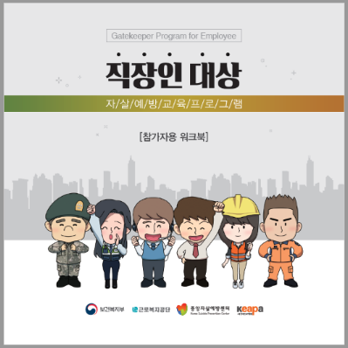
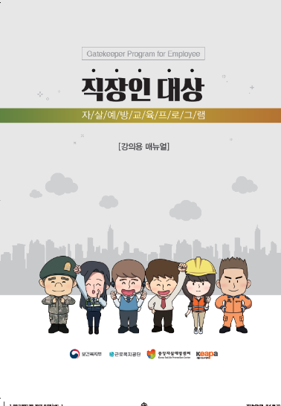
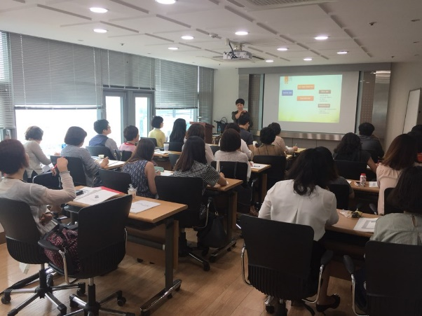
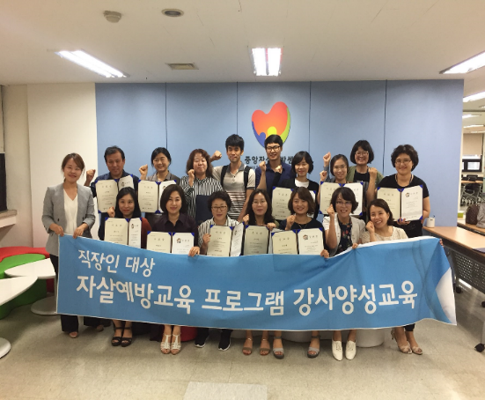
Training gatekeepers and instructors for early detection and preventing suicide
Workbook
Training instructors
Training instructors
Manual for instructors

Slide 82
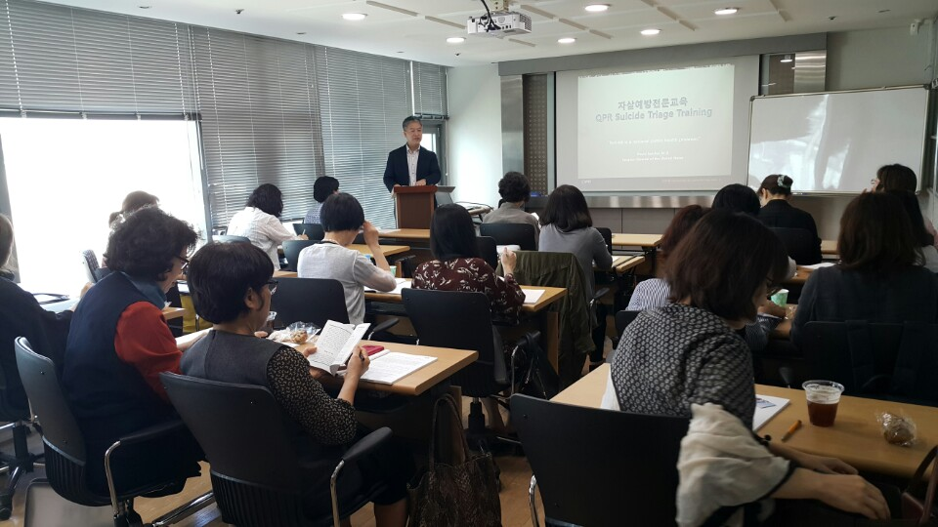
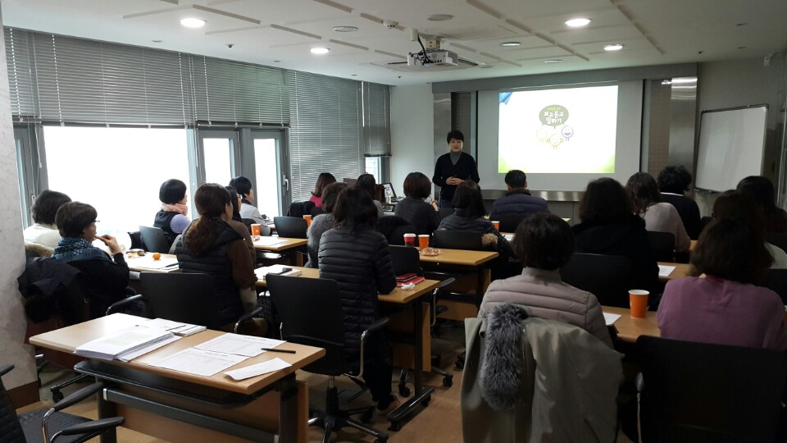
Suicide Prevention Training for KEAPA Counsellors
QPR education
KASP education of “See-Listen-Tell” program

Slide 83
Keep the Conversation Going
Dr. Jodi Jacobson Frey
jfrey@ssw.umaryland.edu
Dr. Kaoru Ichikawa
kaoru.ichikawa@eapatokyo.org
Dr. Paul Jongmin Woo
jongmin.woo@gmail.com

