Slide 1


The Challenges of EAP and
Eldercare Caregiving
National Behavioral Consortium
June 17, 2015
Boulder, Colorado
Patricia A. Herlihy Ph.D., RN
Kathleen Greer, LMHC
Sandra Caffo LCSW, LMFT, CEAP

Slide 2
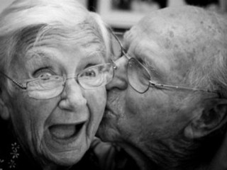

Slide 3
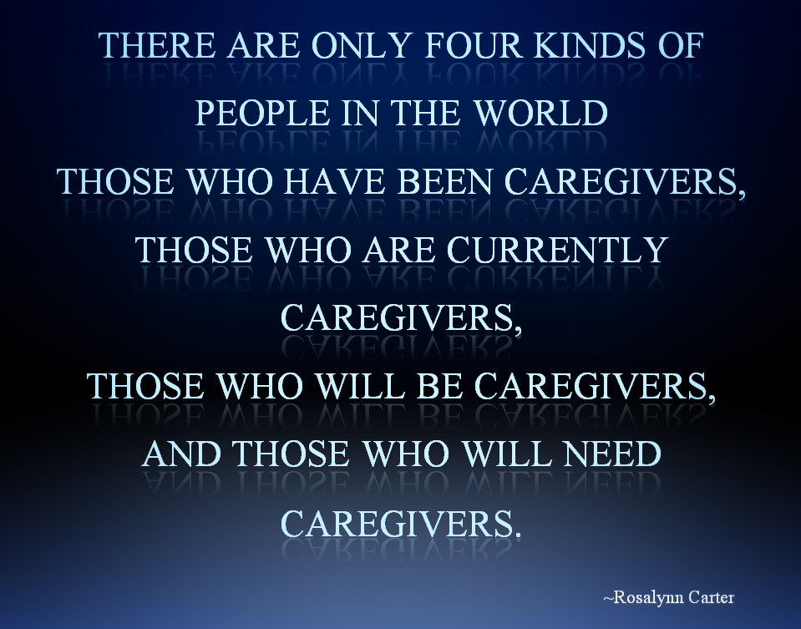

Slide 4
Overview
Definitions & Statistics - Elder Care/Caregivers/Older Adults
Review Current Trends regarding Elder Services
Review NBC Elder Care Survey Data
Discuss the Role of EAP re: Elder Care/Older Adults
Brainstorm Ways to reach HR/Benefits Personnel

Slide 5
Definitions & Statistics

Slide 6
CAREGIVERS AND CAREGIVING
Who is a Caregiver?
A caregiver is an unpaid individual involved in assisting others with activities of daily living and/or medical tasks.
Spouse
Partner
Family Member
Friend
Neighbor
What is the Extent of Caregiving?
43.5 million of adult family caregivers care for someone 50+ years of age
14.9 million care for someone who has Alzheimer's disease or other form of dementia.
  80% of home care is by unpaid caregivers in the US
66% of caregivers were employed while providing care

Slide 7
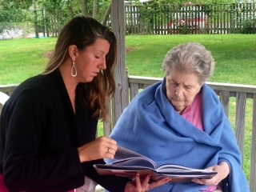
Caregivers Getting Younger
Many Faces of Caregiving
Online survey with a random sample
of 1043 Millennials & Gen Xers
Report providing some type of caregiving on a daily basis
Millennials (67%)
Gen-Xs (55%)
Types of Care:
42% supporting someone with emotional/mental health condition
35% memory problem/dementia
27% with a primarily a physical condition
Source Mass Mutual Financial 2015

Slide 8
Where do Caregivers turn for help?
72% of caregivers gather health information online – particularly about medical problems, Treatments and drugs
70% of caregivers say they turned to friends and family members for information, care, & support
28% of caregivers say they turned to others who have the same health condition….
Note: Caregivers turn to friends and family

Slide 9
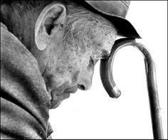
Societal Factors Impacting this Topic
  Influencing Factors
  Increase in Older Workers
  Aging Baby Boomers
  94% of Corporations provide Elder Care Services
  Life Span increasing
  Increase in Programs re: End of Life Decisions

Slide 10
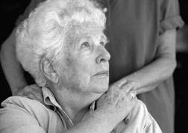
Caregiving and the Workplace
Notes:
Next Title Holder – comes quick… but will try and pace this section so not too obvious

Slide 11

Number of Caregivers in the Workplace
66% of caregivers were employed while providing Elder Care
73% of male caregivers & 60% of female caregivers were employed while providing Elder Care

Slide 12
Elder Care Services Provided by Employers
The Elder Care Study: Everyday Realities and Wishes for Change (2010)
42% of Individuals in the Workforce
had provided Elder Care in the last 5 years
Employer Services Provided | 2008 | 2014
Elder Care R&R | 31% | 43%
Dependent Care Programs | 23% | 41%
Respite Care | 3% | 7%
Time off for Elder Care Tasks | 75% | 75%
Note: Relatively low increase in Elder Care Services
Source: Families & Work Institute 2014 National Study of Employers

Slide 13

Aging of the
American Workforce

Slide 14
Aging of the American Workforce
Aging of US population Increasing
  In 2010 Older Americans (age 65+) comprised 13% of US population
  Projection for 2030 – older Americans will comprise 19% of US population (72 million older Adults)
Projections of Mature Workers continuing to stay on the job longer
  In 2010- 19% of people over 55 staying on the job
  In 2013 -21.8% of people over 55 remained in the workforce
  By 2020 – 25% of people over 55 will stay on the job

Slide 15
The Aging Workforce
  SHRM Foundation Executive Roundtable – June 2014
  Initiating a 3-year National Initiative “The Aging Workforce”
  (Grant from the Sloan Foundation)
  Major Themes:
  New Strategies are needed to retain older workers.
  A more structured method of knowledge transfer is required.
  Older Workers (& those who supervise them) often must contend with family-related factors that younger workers do not.
  Older Workers may have unique personal health concerns.
  Intergenerational conflict is real.

Slide 16

NBC Elder Care Survey

Slide 17
Convenience Sample (NBC EAP Members)
What is your current utilization rate concerning
eldercare services?
*80% response rate to survey

Slide 18
Utilization Rates of Eldercare Services
What is your current utilization rate
concerning eldercare services?
Note: 83% of those surveyed see less than 2% utilization for eldercare services.

Slide 19
Utilization Predictions
How does your current utilization of eldercare services compare to the same statistics from 2012?
Projecting out 3 years to 2018,
What would you estimate the utilization of eldercare services to be?
Same 67%
Higher 17%
Lower 8%
Same 42%
Higher 58%
Lower 0%
Note: Prediction indicates increased Elder Care Services….

Slide 20
Eldercare Services Provided
What eldercare consultation and referral
services does your company provide?
Adult daycare (100%)
Companion services (67%)
Community services (83%)
Emotional support for caregivers (92%)
Financial consultation (92%)
Hospice (75%)
Info regarding assisted living/nursing homes (92%)
In-home services, housekeeping, meals (67%)
In-home services, nursing care (75%)
Legal consultations (92%)
Life alert (58%)
Respite for caregiver (75%)
Transportation (67%)
Other: Speaking with parents

Slide 21
How Services Are Provided
How does your company provide eldercare
consultation & referral services?
Internally via our company products
Through a work-life partner
Through
a myriad of vendor partners depending on the need.
Both internal and external

Slide 22
Comments about Predictions
“Level and interest of these services has been constant for many years.”
“Demographics: baby boomers are retiring in drove, elder population growing, people living longer.”
“Utilization has gone up over the past 5 years and will continue to increase.”
“Promotion doesn’t seem to work.”
“Unless we change our promotion or focus of these programs, we won’t see any change.”

Slide 23
Educational Programs Offered
What type of educational programs/webinars do you
provide to your clients on the topic of eldercare?
  Caregiver stress (83%)
  Eldercare and adult planning (67%)
  Medicare (42%)
  Other (25%)
  No requests/Maintaining mental capacity/Robust list of services
Do some eldercare issues get documented under
other categories such as legal or financial?
  Yes (83.3%) No (16.7%)

Slide 24
Categories for Legal and Financial
When tracking utilization for legal and financial cases,
does your company break down the data into any
of the following sub-categories?
Note: the majority of EAPs do not break out this data.

Slide 25
Company Philosophy about Eldercare
What is your company’s philosophy about the
appropriate role for EAP as it relates to eldercare?

Slide 26
Additional “buy-up” services
What additional programs are your client organizations purchasing, considering purchasing and/or promoting form other vendors that relate to eldercare?
Back-up care for eldercare needs
Care.com
eCareDiary.com
Geriatric care management services through Senior Bridge
In-home consultations
Web-based elder care advisory services
None or unknown (25%)
Comment: “We have had very little success selling buy-up services.”

Slide 27
Concerns and Challenges
What is your company’s biggest concern/challenge
in terms of providing eldercare services?
Getting the important & necessary information to elders & caregivers
Disconnect between known needs & reality of low usage of WL services
How to work with customers to promote services
Watching people wait until there is a crisis
Gaps in funding
Needs greater than we can provide
Groups express interest but actual calls minimal
Creating awareness of what is offered by EAP

Slide 28
Final Survey Thoughts…
Other thoughts on EAP/eldercare issues?
“It would seem that EAPs should play a larger role.”
“Cultural competence and how to work with clients from other countries with parents in home country.”
“It is frustrating that we can’t get more usage out of this service.”
“Gaps of funding which leave many older adults and caregivers with a huge financial burden.”

Slide 29

Discussion & Brainstorming

Slide 30

Discuss EAPs Role with Elders/Caregivers & Older Americans in the Workforce
Is Eldercare on your radar as an EAP?
Why is EAP utilization so low?
Should we track utilization differently?
Do we want to see better usage?
How far should EAPs go in service delivery to elders and caregivers?
What are customers asking for?
What is our obligation to educate customers about eldercare needs?

Slide 31

Side Effect of Integration of EAP & Work Life Services
93% Integrated in some fashion
62% Prediction for Market Integrated
33% Claim to be Integrated
23% Claim to be Integrated
10% Claim to be Integrated

Slide 32

Next Steps….

Slide 33









Resources

Slide 34

Thank You…

