Slide 1
Background on the Promoting Safe and Stable Families Program
Richard P. Barth, PhD, MSW
rbarth@ssw.umaryland.edu

Slide 2
Child Welfare Services Goals
Protect the safety of children against child abuse and neglect
Provide parents with a reasonable opportunity to improve parenting so that they can continue or resume custody and care of their children
Promote children’s permanent life-time relationships with parents, kin, or other resource parents—primarily adoptive parents or guardians

Slide 3
Brief Legislative History
1935: Title IV-B of the Social Security Act created to provide preventive and protective services and foster care payments
1961: Title IVE is created as foster care entitlement
1993: Title IV-B, Subpart 2 created to provide state grants for family support and family preservation services
1997: Adoption and Safe Families Act renames to PSSF, adding time-limited family reunification and adoption promotion and support
2001: added $200 million in authorized discretionary funding
2005: Deficit Reduction Act added $40 million in mandatory funding
2006: Child and Family Services Improvement Act targeted the $40 million to address methamphetamine and other substance abuse (regional partnership grants) and child welfare worker visits

Slide 4
Promoting Safe and Stable Families (PSSF) SUB Part 2 |  | 2011 Funding
PSSF—Child and Family Services | Formula grants with four categories of services: | $341 m
(Secs. 430-437) | (1) family preservation, (2) family support;
 | (3) time-limited family reunification, and
 | (4) adoption promotion and support .
PSSF—Targeted Purpose: Improve | Formula grants to states and territories to support quality, | $20 m
Caseworker Visits (Sec. 436(b)(4) | monthly caseworker visits with children in foster care.
PSSF—Targeted Purpose: Improve | Competitive grants to regional partnerships to | $20 m
Outcomes of Children Affected by | improve services available to children in substance-
Parental Abuse of “Meth” or Other | abusing families to increase children’s well-being
Substances (Secs. 436(b)(5) and 437(f)) | and improve their permanency outcomes.
PSSF—Court Improvement Program | Formula grants to state highest courts to improve | $32 m
(CIP) (Secs. 436(b)(2); 437(b)(2); & | (1) handling of child welfare proceedings,
438. | (2) data collection and analysis to achieve better
 | and more timely outcomes for children, and
 | (3) training related to child welfare proceedings.
PSSF—Research, Evaluation, Training | Funds reserved to HHS for support of program-related | $8 m
(Sec. 436(b)(1);Sec 437(b)(1) & Sec.435) | evaluation, training, research, and technical assistance.
Mentoring Children of Prisoners | Competitive grants to community-based, public, or | $0
(Sec. 439) | private entities to provide mentoring services.

Slide 5
Four Pillars of PSSF
Family support services are intended to help families provide safe and nurturing environments for children
Family preservation services are intended to assist families in crisis and to prevent placement and replacement into foster care and include respite, parent skills training and safe haven programs
Time-limited family reunification services help families address the risks that led to removal of a child and include counseling, mental health and substance abuse treatment, domestic violence, and crisis nurseries
Adoption promotion and support services help families that are preparing to adopt or that have adopted a child from foster care

Slide 6
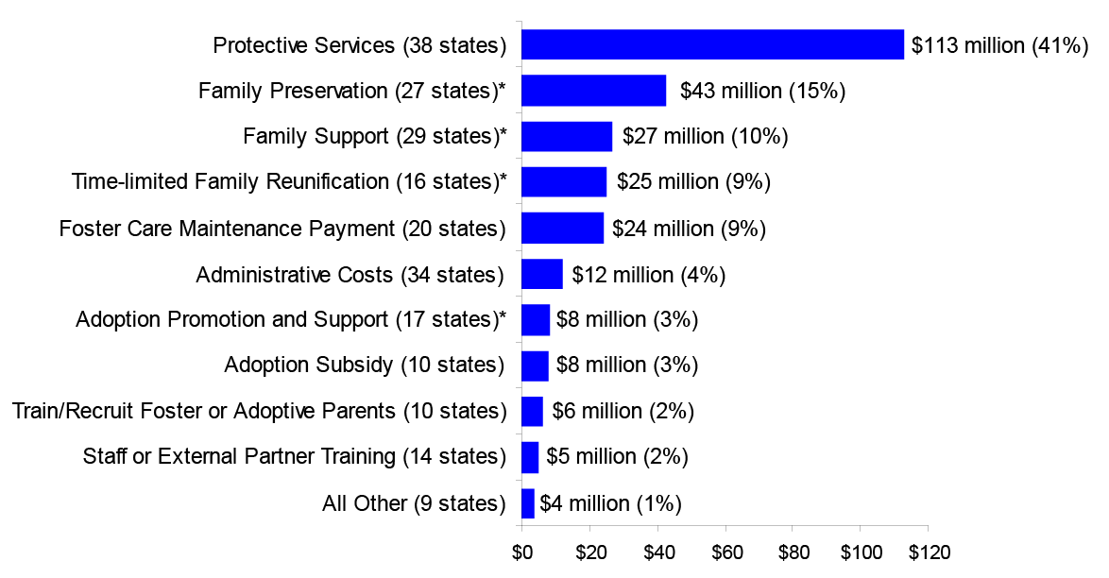
How is the Money Used?
Planned Use of FY2010 Federal CWS Funds by Service or Activity*
*Estimated spending for 52 jurisdictions; Source (Stoltzfus, 2011)

Slide 7
PSSF and CAPTA
CAPTA (child abuse prevention and treatment)has been re-authorized and expanded to now require that children who are:
  born drug or alcohol exposed are referred to CWS
  are substantiated victims of abuse and are 0-3 years of age are referred to early intervention services
  Impact: The need for professionals to coordinate and deliver early childhood in-home services has grown

Slide 8
PSSF and Foster Care
In 1993 report, GAO found that: the ratio of IV-E expenditures to IV-B appropriations was about 2 to 1; by 1992 this ratio was 8 to 1 (with a concurrent decline in CWS spending under Title XX)
In 2011, the ratio of foster care expenditures (including IVE and Chafee Funds) to PSSF funds was $6707m to $428m or about 16 to 1*
  Impact: The need for services to support placement prevention and family reunification remains high
*Source: Stoltzfus (2011 b: Table 2)

Slide 9
PSSF and Adoption
Adoption policies have been robust and have succeeded in doubling the number of adopted children to 50,000 a year or more since 2003.
  More children are now adopted from foster care
  (> 500,000) than there are in foster care (<500,000)
  Impact: The number of children and families who could
  use post-adoption services has grown

Slide 10
Summary
PSSF has developed over 30 years to help support birth and adoptive families involved with CWS (and to prevent their CWS involvement by providing family support)
The support has been bipartisan
The success of the American adoption program has generated additional demand for effective adoption support services
The commitment to providing parents with reasonable opportunities to improve their parenting is fundamental to the principals of the child welfare services program

Slide 11
References
Stoltzfus, E. (2011a). Child Welfare: Funding for Child and Family Services Authorized Under Title IV-B of the Social Security Act. Washington, DC: Congressional Research Service
Stoltzfus, E. (2011b). Child Welfare: Recent and Proposed Federal Funding. Washington, DC: Congressional Research Service
U.S. GAO (1993). Foster Care: Services to Prevent Out-of-Home Placements Are Limited by Funding Barriers. Washington, DC: US Government Printing Office (HRD 93-76)

