Slide 1
Implementing School and Evidence-Based Interventions for Children from
Families that are Poor
Richard P. Barth
Promise Heights Interns
September 3, 2013
rbarth@ssw.umaryland.edu

Slide 2
Overview of Keynote
SUMMARY: What I think I’m going to tell you
Grand Challenge of Poverty and Poverty’s Impact on children, families, teachers, other school personnel, schools, and communities
INTERVENTIONS
  All community interventions
  All-school interventions
  Family interventions
    The Incredible Years
    Attendance
    Nurse Home Visiting
    Family Check Up
SUMMARY (if I have time): What I hope I told you!
References

Slide 3

Note: I AM LEARNING, TOO!
My GaGa is an expert about some stuff, he tells me, but not about this!

Slide 4
Summary
Poor educational outcomes are multiply determined—and must be addressed at several levels
We have evidence based tools to address some of the levels—but primarily at the level of the student and classroom
We have emerging tools to address problems at the level of the family—this can and should still be done
We have good reason to address problems at the level of the neighborhood and school.
Intervention success is unlikely without effective tools at all levels

Slide 5
Background on Poverty in USA
The number of families in deep poverty grew sharply during the recent recession and its aftermath, and in 2010, the share of Americans whose families made less than half of the poverty line hit a record: 6.7 percent of the population, or 1 in 15 Americans.
In 2010, 1 in every 10 American children lived in deep poverty.

Slide 6
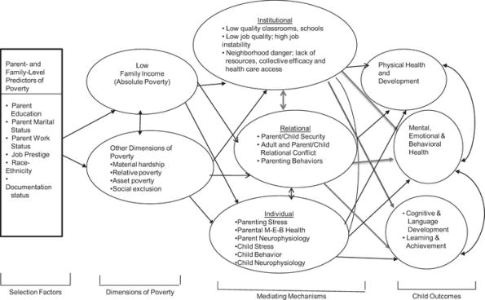
Poverty: Complexly Intertwined Impact
Institutional Effects
Institutional
Parent- and
Family-Level
Predictors of
Poverty
Parent- and
Family-Level
Predictors of
Poverty
Low
Family Income
Physical Health & Development
• Parent
Education
• Parent Marital
Status
• Parent Work
Status
• Job Prestige
• Race-
Ethnicity
•
Documentation
status
Relational
Mental,
Emotional &
Behavioral
Health
Other Dimensions of
Poverty
Individual
• Cognitive &
Language
Development
• Learning &
Achievement
Selection Factors
Dimensions of Poverty
Mediating Mechanisms
Child Outcomes

Slide 7
Community Agency Effects
Erin Godfrey and Hirokazu Yoshikawa examined the impact of welfare office characteristics on children’s education (Child Development 2012).
  Caseworker support, caseload size, and emphasis on parental employment predicted children’s reading and math achievement and internalizing behavior five years later!

Slide 8

Shonkoff, J. et al. and the Section on Developmental and Behavioral Pediatrics, Committee on Psychosocial Aspects of Child and Family Health, Committee on Early Childhood, Adoption, and Dependent Care. (2011). Early Childhood Adversity: Toxic Stress, and the Role of the Pediatrician: Translating Developmental Science Into Lifelong Health, Pediatrics, originally published online December 26, 2011.

Slide 9
AAP Report on Toxic Stress:
1 of 5 Main Recommendations
RECOMMENDATION 2.
The growing scientific knowledge base that links childhood toxic stress with disruptions of the developing nervous, cardiovascular, immune, and metabolic systems, and the evidence that these disruptions can lead to lifelong impairments in learning, behavior, and both physical and mental health, should be fully incorporated into the training of all current and future physicians (and all other health service providers) [material in parentheses and bright red text not in the original].

Slide 10
CAPTA Early Intervention Study: Summary
Based on Measured Delay and/or High Risk, 79% of CWS investigated children were identified as having a measured delay or high risk status
  Children with more than 5 recognized risk factors at baseline re almost certain to develop measured delays that remain at 36 months

Slide 12
Cumulative Risk & Effects on 3rd Grade Reading (R) & Math (M), Truancy (T), Conduct (C) & >1 Suspension (S)
Prevalence of individual and cumulative risk, Percentage of the Total Sample, and Significant relationship to key outcomes (N= 10,738)
Risk factors % Academic Truancy & Beh
Inadequate prenatal care 34.4 (R,M)
Preterm/low birth weight 20.9 (R,M)
High lead exposure 21.3 (R,M)
Teen mother 24.7 (T,C,S)
Low maternal education 26.2 (R,M) (T,C,S)
Homelessness 9.2 (M) (C,S)
Child maltreatment 10.9 (R,M) (T,C)
Cumulative risk (not including poverty)
No risk 1
One risk 1.3X* 1.8X*
Two risks 1.6X* 2.0X*
Three or more risks 1.9X& 2.5X*
Source: Rouse, Fantuzzo, & LeBoeuf, 2011; * indicates that these are average (R+M) ORs

Slide 13

Although noxious and under-stimulating environments may worsen odds for children, the impact of allostatic load and other factors impairing executive functioning most affects the achievement of poor children!

Slide 14
Early Adversity is a Better Predictor of Behavior Problems than Prenatal Drug Exposure
What are the effects on behavior of children?
What are the effects on executive functioning of children
  Direct, indirect, interactive
Early Adversity (EA): 10 Risk Factors
  Parental MH/SA, community violence, HOME, abuse, income, …

Slide 15
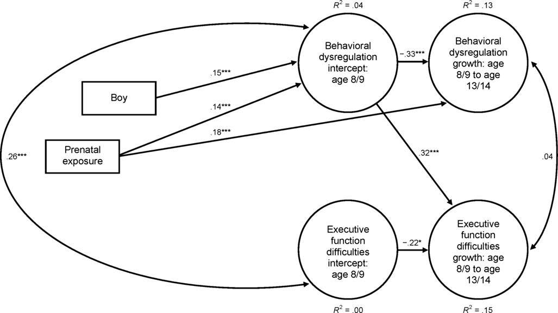
Prenatal Drug Exposure to Behavioral Dysregulation or Executive Functioning Difficulties
Model explains about 15% of variance in behavior and Executive functioning

Slide 16
Model with Early Adversity Added
.00***
35***
Early Adversity
. 39***
Model explains about 25% of variance in behavior and executive functioning
Fisher, P. A., Lester, B. M., DeGarmo, D. S., Lagasse, L. L., Lin, H., Shankaran, S., . . . Higgins, R. (2011). The combined effects of prenatal drug exposure and early adversity on neurobehavioral disinhibition in childhood and adolescence. [Article]. Development and Psychopathology, 23(3), 777-788. doi: 10.1017/s0954579411000290

Slide 17
What?
Being prenatally drug exposed is a challenge for children but almost all of that challenge results from the adverse developmental environment that children experience.
Behavioral dysfunction stabilized but executive functioning got worse over time (primarily as a result of drug exposure and early adversity although both PDE and EA contribute)
Post Natal Environments Matter as Much as Pre-Natal Environments, so the impact of PDE is not fixed!

Slide 18
Early Adversity is Not Irreversible
At least parenting can be taught to be safer
  Safe Care (now being tested with Parents as Teachers)
  Parent Child Interaction Therapy
  The Incredible Years (also includes Teacher and child interventions)
  Multi-dimensional Treatment Foster Care
  ALL HAVE SHOWN SUCCESS WORKING WITH VERY TROUBLED ABUSIVE FAMILIES AND ABUSED CHILDREN

Slide 19
Poverty & Trauma’s Effects on Executive Functioning are Not Irreversible
Children who get responsive predictable parenting and are taught how to be more effective in making decisions and sustaining self-regulation are going to be the successes (Paul Tough)! (Tuesday October 30th, 9AM, SSW.)
Phil Fisher has shown that the brains of young children in foster care change as a result of contingent responsive parenting when compared to other foster children.

Slide 20
Morning Cortisol Levels By Group,
Baseline To 15 Months
Community
TFC-P
Regular FC
Fisher, Stoolmiller, Levine, & Gunnar (in prep)

Slide 21
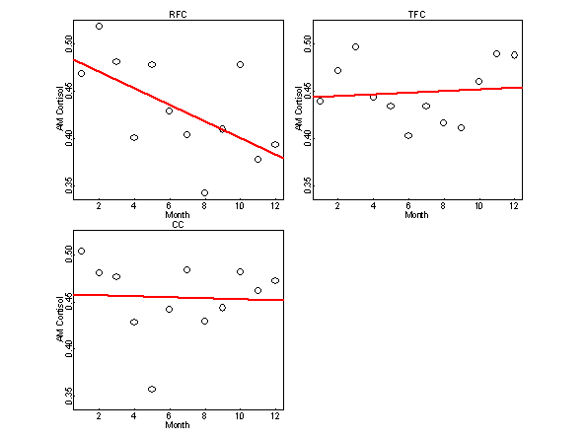
Positive Morning Cortisol Levels By Group,
Baseline To 15 Months
Regular foster care
MTFC-Pre
Fisher, Stoolmiller, & Gunnar (2007), Psychoneuroendocrinology
Community Comp

Slide 22
Intervention Effects On Executive Functioning
CC
Correct
Incorrect
MTFC-P
Correct
Incorrect
RFC
16
Correct
Incorrect
Children in Regular Foster Care Do Not Respond Differently to Positive and Negative Feedback
Children in MTFC-P respond more normatively
14
12
10
8
6
4
2
0
-200
-100
-2
0
100
200
300
400
500
600
700
800
-4
-6
Bruce, Martin-McDermott, Fisher, & Fox (under review)
-8
-10
-12

Slide 23
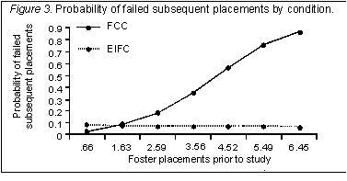
Effect Of Prior Out-of-home Placements On Permanent Placement Failures, MTFC-P Vs. Regular FC
RFC
Predictable Placement Moves
MTFC-P
Actual moves for MTFC group
Prior poor and unstable history can be overcome!
(Fisher, Burraston, & Pears, 2005)

Slide 24
WHAT?
The best path to improved outcomes for children and parents is evidence-based parent training (family work), based on social learning models, that have now been shown to be very effective at improving parenting and child behavioral outcomes… but will they also improve educational outcomes?
NOT YET BROADLY SHOWN

Slide 25
Community Level Interventions
Are they facilitative of student success? VERY LIKELY!
Can they be effective? WE THINK SO!
Are they proven? Not yet!
Will Dobbie and Roland Fryer in the American Economic Journal—Applied Economics, July, 2011…
“We conclude with evidence that suggests high-quality schools are enough to significantly increase academic achievement among the poor. Community programs appear neither necessary nor sufficient.”

Slide 26
So, Why Do We Bother?
Not Necessary… (but can you really reduce toxic stress without reducing aversive community conditions)?
Not Sufficient? (yet, in the Fisher MLS study they did not look at quality of schools or curriculum)
Facilitative?
Accelerative? Perhaps learning by children and Expeditious? parents is easier with fewer fears
Or, just HUMANE?

Slide 27

WHOLE School Level Reforms
Chicago Teacher’s Union call for more social workers and social services at high poverty schools, to give teachers in those schools and their students a fair chance of success

Slide 28

School Level Reforms
Consortium on Chicago School Research (Bryk et al, 2010) shows that “truly disadvantaged schools can improve substantially if they implement proper organizational structures”
  “community factors accounted for most of the difference in stagnation rates among schools needing improvement”
  Yet 1/3rd of these schools did improve!

Slide 29
Organizing Schools for Improvement
  ESSENTIAL SUPPORTS (Note: Sustained weakness in just one of these areas undermined virtually all attempts at improving student learning)
  School leadership
  Parent community ties*
  Professional capacity
  Student centered learning climate*
  Instructional guidance
*Starred items are likely to require significant social services if they are to be achieved in high poverty communities
Source: Bryk et al (2010)

Slide 30
Chicago Area Schools in Areas with High Child Abuse Rates…
Had a 2% chance of having strong essential supports in place (even though 20% of all Chicago Public Schools had them in place)
Communities with many abused children (whether at home or in foster care) are doubly troubled

Slide 31
School Use of Child Level Data to Help Individuals
87% of 9th graders who missed 0-4 days of school, later graduated; BUT only 1% of freshman who missed 30 days or more, later graduated from high school
86% of students with a freshman GPA of 2.5 graduated, only 35% of those with a 1.5 GPA or lower, later graduated
DO YOU KNOW WHERE YOUR 9th GRADERS ARE?

Slide 32
Another Whole School Intervention Approach
The Turnaround for Children model posits that if high poverty schools develop the capacity to address poverty-related barriers to learning, and if this capacity-building and culture change is coupled with what has been learned from other innovative models (about effective leadership and teaching, extended learning time, and the need for common core standards), then widespread, scalable, and sustainable system reform in America’s lowest performing public schools is truly possible. ..

Slide 33
Turnaround for Children Model
BIG POINT. Fund school-centered services that: (1) institutionalize the role of a school-based clinical social worker; (2) improve funding for evidence-based prevention and intervention strategies (e.g., counseling) that can preempt more expensive mental health and Special Education services; and (3) improve the integration of schools and child-serving systems by expanding public funding streams to cover current funding gaps (e.g., for case management, crisis intervention services, family outreach, and teacher consultation).
Mandate the incorporation of systems of support, culture change, and service integration into all reform options (transformation, turnaround, alternative management, and restart) for high poverty schools and school districts, that incorporate implementation science in their dissemination
Provide adequate funding for interventions for children with intense needs (e.g., autism, developmental disabilities, severe mental health issues).
Promote the development of student support and climate measures that can be incorporated into accountability systems, and establish incentive structures that promote the adoption of school culture and climate improvement models.
Establish standards and provide funding for leader and teacher preparation that addresses poverty-related barriers in high poverty schools.

Slide 34
TFC School & Student Support Model
Since 2005, TFC has worked in over 60 of the lowest performing public schools in New York City (TFC is a three year program).
Comprehensive student support systems are introduced through three problem-solving teams that focus on behavior, academics and school climate. The Student Intervention Team (SIT) assumes care management for students at the highest level of behavioral and social need... The SIT reviews highest-risk students’ needs, and develops and monitors intervention plans for in-school counseling and referral to outside services.
The TFC model focuses on the most challenging students first because a small percentage of extremely high need students can be so negatively charismatic that they destroy a school culture and make It virtually impossible for teachers to teach and students to learn.

Slide 35
When is it Just Too Late?
The Pathways to Education project began because of a community (parents) request to a local health agency to help their children succeed in high school. The community consisted mainly of people from a public housing complex, with the majority of families being poor, immigrants and from visible minority groups. The Pathways project grew out of a partnership between the community, the health centre and the school board, and was funded by a variety of sources.
Pathways has been running for six years, and the results for the first five cohorts of students have been exciting. In comparison to a pre-project cohort:
  the absentee and academic ‘at-risk’ rate has fallen by 50% ,
  the ‘dropout’ rate has fallen by 80% to a level below the average for district
  the five-year graduation rate has risen from 42% to 75%.
Of the graduates, 80% go on to college or university, compared with 42% before the Pathways project. While these initial results must be replicated in other communities, they suggest that, even at the high school level, it’s never too late ncbi.nlm.nih.gov/pmc/articles/PMC2528798/

Slide 36

The Big Secret is Family Interventions as a Part of All Levels of Intervention

Slide 37
Family Nurse Visiting & Attendance (Kerr, et al, 2011)
Children from families earning less than 300% of the federal poverty level were four times as likely to have chronic absences than children above that level (Romero & Lee, 2008)
Frequent movement affects chronic absenteeism
  parents dealing with job loss, divorce, housing problems including substandard housing, foster care, domestic violence, or parents’ involvement in the criminal justice
We know that maternal depression, mental illness, and substance abuse can increase rates of school absence
Chronically absent children don’t have routines for school preparation
  children may be left alone in the morning
  if they miss the bus they do not attend school
  Some parents do not want their children to travel alone even one block

Slide 38
School Nurse Outreach Intervention (Kerr, et al, 2011)
Intervention focused on contacting parents of children with 10% of school year absent for illness-related reason
  Family Nurse Practitioner (FNP) called family when student reached 10% of year absent due to illness
    If parent confirmed illness, FNP schedule follow-up home visit or in school appointment
  Each call included a brief discussion of the importance of school attendance
  If student reached 20% absences or parent agreed to home visit, FNP and social worker would go to home
  Home visit could include physical examination if allowed by parent
    All home visits included a brief discussion of importance of school attendance and flyers about attendance with contact info to leave in the home

Slide 39
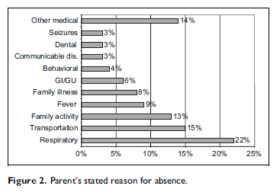
Real Causes of Absenteeism (Kerr, et al, 2011)
40% of absences reported as illness/injury in fact related to transportation, family activity, or family illness (not student illness)

Slide 40
Main Outcome… (Kerr, et al, 2011)
There were statistically significant increases in attendance from Year 1 to Year 2 at p < .05, at the elementary level (but not in Head Start)
Largest effect of the intervention was the school community’s awareness that someone in the school was checking attendance!

Slide 41

The Incredible Years (TIY): Working with Children, Parents, and Teachers
Children of parents who are involve in joint activities with them (playing games, preparing/clearing meals, discussing school) have a significant association with child educational attainment
TIY was offered along with SPOKES reading program (Supporting Parents on Kids’ Education in School)
  offered at 4 public schools in high poverty areas
  18 week (1.5 school term) intervention – 12 week IYBP + 6 week reading program
  Each parent visited in home at least once
  Schools also offered general practitioner medical services, additional therapeutic services (OT, speech, etc), mental health services, and other mores specific referrals
Parents showed increase in parental sensitivity and child-centered parenting – effects continued at least 6 months after end of intervention
Children showed improvement on task attendance and concentration – no evidence though that this showed lasting effects
Parents and children use the same props/toys to learn to go slow, stay in time out, and learn

Slide 42
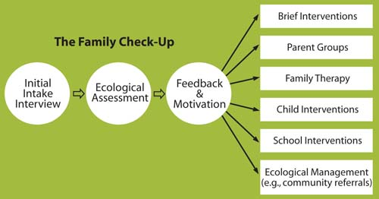
Family Check Up: Assessment Driven & Tailored

Slide 43
Family Check Up Results
Randomly assigned middle school adolescents showed significant reductions in late adolescence (age 18-19), growth in family conflict, alcohol use, and involvement with deviant peers (Van Ryzin, Stormshak, & Dishion, 2012).
Lessons Learned from Family Check Up
  To prevent child behavior problems there may be a need to intervene early and directly with:
    (a) the emotional climate of the family and
    (b) the emotional climate of the parenting relationship

Slide 44

The Grass Isn’t Greener on the “other side” or on “your side” it’s greener where you water it…
We have to more thoroughly water family interventions if we will best assist our poorest children

Slide 45
Thank you for this opportunity.
YOU, together, can make the changes our children need!

Slide 46
References
Bryk, A.S., Sebring, P.B., Allensworth, E., Luppescu, S., & Easton, J. Q. (2010). Organizing schools for improvement: Lessons from Chicago. Chicago: University of Chicago Press.
Cantor, P.A., Smolover, D.S. & Stamler, J.K. (2011). Innovative Designs for Persistently Low-Performing Schools: Transforming Failing Schools by Addressing Poverty-Related Barriers to Teaching and Learning. New York, NY: Turnaround for Children, Inc.
Chang, H. N., & Romero, M. (2008). Present, engaged, and accounted for: The critical importance of addressing chronic absence in the early grades. National Center for Children in Poverty, Columbia University Mailman School of Public Health. Retrieved January 10, 2009, from www.aecf.org
Dobbie, W., & Fryer, R. G. (2011). Are High-Quality Schools Enough to Increase Achievement Among the Poor? Evidence from the Harlem Children's Zone. [Article]. American Economic Journal-Applied Economics, 3(3), 158-187. doi: 10.12
Fisher, P. A., & Stoolmiller, M. (2008). Intervention effects on foster parent stress: Associations with child cortisol levels. [Article]. Development and Psychopathology, 20(3), 1003-1021. doi: 10.1017/s0954579408000473
Fergusson, D. M., Grant, H., Horwood, L. J., & Ridder, E. M. (2005). Randomized trial of the early start program of home visitation: Parent and family outcomes. Pediatrics, 116, e803-e809.
Fisher, P. A., Lester, B. M., DeGarmo, D. S., Lagasse, L. L., Lin, H., Shankaran, S., . . . Higgins, R. (2011). The combined effects of prenatal drug exposure and early adversity on neurobehavioral disinhibition in childhood and adolescence. [Article]. Development and Psychopathology, 23(3), 777-788. doi: 10.1017/s0954579411000290

Slide 47
References
Gall, G., Pagano, M. E., Desmond, M. S., Perrin, J. M., & Murphy, J. M. (2000). Utility of psychosocial screening at a school-based health center. Journal of School Health, 70, 292-298.
Kerr, J., Price, M., Kotch, J., Willis, S., Fisher, M., & Silva, S. (2012). Does contact by a family nurse practitioner decrease early school absence? The Journal of School Nursing, Vol. 28, No. 1 (38-46). DOI: 10.1177/1059840511422818
Olds, D. L., Kitzman, H., Hanks, C., Cole, R., Anson, E., Sidora-Arcoleo, K., . . . Tutt, R. A. (2007). Effects of nurse home visiting on maternal and child functioning: age-9 follow-up of a randomized trial. Pediatrics, 120, e832-e839.
Gilman, S. E., Kawachi, I., Fitzmaurice, G. M., & Buka, S. L. (2003a). Family disruption in childhood and risk of adult depression. American Journal of Psychiatry, 160, 939–946. doi:10.1176/appi.ajp.160.5.939.
Godfrey, E. B., & Yoshikawa, H. (2012). Caseworker-Recipient Interaction: Welfare Office Differences, Economic Trajectories, and Child Outcomes. [Article]. Child Development, 83(1), 382-398. doi: 10.1111/j.1467-8624.2011.01697.x.
Harding, D. J. (2003). Counterfactual models of neighborhood effects: The effect of neighborhood poverty on dropping out and teenage pregnancy. American Journal of Sociology, 109, 676–719. doi:10.1086/379217
Li, J. L., & Julian, M. M. (2012). Developmental Relationships as the Active Ingredient: A Unifying Working Hypothesis of "What Works" Across Intervention Settings. [Article]. American Journal of Orthopsychiatry, 82(2), 157-166. doi: 10.1111/j.1939-0025.2012.01151.x
McLoyd, V. C. (1989). Socialization and development in a changing economy: The effects of paternal job and income loss on children. American Psychologist, 44, 293–302. doi:10.1037/0003-066X.44.2.293

Slide 48
References
Pitner, R. O., Yu, M., & Brown, E. (2012). Making neighborhoods safer: Examining predictors of residents’ concerns about neighborhood safety. Journal of Environmental Psychology, 32(1), 43-49. doi: http://dx.doi.org/10.1016/j.jenvp.2011.09.003
Reynolds, A. J., Temple, J. A., Robertson, D. L., & Mann, E. A. (2002). Long term effects of an early childhood intervention on educational achievement and juvenile arrest. Journal of the American Medical Association (JAMA), 285, 2339-2346.
Romero, M.,&Lee, Y. (2008). The influence of maternal and family risk on chronic absenteeism in early schooling. National Center for Children in Poverty, Columbia University Mailman School of Public Health. Retrieved January, 10, 2009, from www.aecf.org
Strolin-Goltzman, J. (2010). The relationship between school-based health centers and the learning environment, Journal of School Health, Vol. 80, No. 3 (153-159).
Van Cura, M. (2010). The relationship between school-based health centers, rates of early dismissal from school, and loss of seat time, Journal of School Health, Vol. 80, No. 8 (371-377).
Van Ryzin, M. J., Stormshak, E. A., & Dishion, T. J. (2012). Engaging Parents in the Family Check-Up in Middle School: Longitudinal Effects on Family Conflict and Problem Behavior Through the High School Transition. [Article]. Journal of Adolescent Health, 50(6), 627-633. doi: 10.1016/j.jadohealth.2011.10.255
Webster-Stratton, C., & Herman, K. C. (2010). Disseminating incredible years series early-intervention programs: integrating and sustaining services between school and home. [Article]. Psychology in the Schools, 47(1), 36-54. doi: 10.1002/pits.20450.
Yoshikawa, H., Aber, J. L., & Beardslee, W. R. (2012). The Effects of Poverty on the Mental, Emotional, and Behavioral Health of Children and Youth Implications for Prevention. American Psychologist, 67(4), 272-284. doi: 10.1037/a0028015.
Yoshikawa, H., Weisner, T. S., & Lowe, E. (2006). (Eds.). Making it work: Low-wage employment, family life, and child development. New York, NY: Russell Sage Foundation.

