Slide 1
How to Boost Psychological Capital to Support Early Sobriety
Lawrence Hedblom
October 8, 2022
EAPA Conference 2022

Slide 2
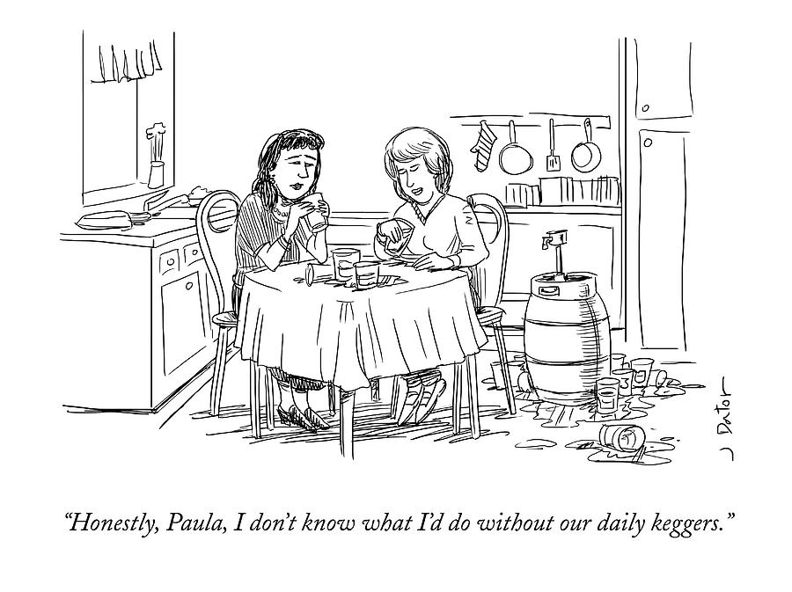
Lockdown

Slide 3

Sobriety
Notes:
Window of opportunity, open and willing doesn’t necessarily stay that way; chance for rebirth and reinvention

Slide 4

Precarious Early Days

Slide 5
The Bridge
Coaching program to support transition from treatment back to regular life
Emphasis on re-entry and integrating back into productive work routine
Ongoing support to help sustain sobriety
Win-win – treatment program and client (plus family)

Slide 6
Agenda
Challenges of early sobriety
Recovery capital
Psychological capital
The Bridge

Slide 7
Early Sobriety
Challenging emotions
Shame
Guilt
Victimized
Low self-esteem
Mood fluctuations
Identity insecurity
Notes:
Tenuous sense of agency
Emotions in early sobriety are like VUCA

Slide 8
Risk for Relapse
Risk for relapse is greatest in early sobriety, especially the first 90 days
No firm statistics, however . . .
  40-60% of people relapse after completing treatment (National Institute on Drug Abuse)
  Roughly 90% of people with alcoholism relapse within 4 years after completing treatment (National Institute on Alcohol Abuse and Alcoholism)

Slide 9

Career Derailment: Top Reasons
Not a team player
  Disrespectful
  Uncooperative
  Don’t share plans or credit
Poor interpersonal relationships
  Too harshly critical
  Insensitive or demanding
  Alienating co-workers and direct-reports.
Rigidity
  Inability to accept feedback about traits they need to improve
  Inability to listen, learn and change
Notes:
Poor interpersonal relationships –
Single biggest and most common factor
Being too harshly critical, insensitive or demanding
Alienating co-workers and direct reports
Rigidity—
Unable to accept feedback they need to change or improve
Unable to listen
Unable to learn and change
Inability to work with a team—
being disrespectful
Uncooperative
Not sharing information, plans or credit

Slide 10
Recovery Capital
Recovery capital includes breadth and depth of internal and external resources that can be drawn upon to initiate and sustain recovery from severe AOD problems. (Granfield & Cloud 2004)
Conceptually linked to solution-focused therapy, strength-based management, resilience, and ideas of hardiness and wellness (White & Cloud 2008)

Slide 11
Recovery Capital
Three types of recovery capital
  Personal recovery capital
    Physical (physical health, financial assets, insurance, basic necessities)
    Human capital (values, self-esteem, self-confidence, self-efficacy, hopefulness, optimism, purpose in life)
  Family/social (intimate relationships supportive of recovery)
  Community (resources, policies promoting recovery - local support institutions, e.g.)
White & Cloud 2008

Slide 12
Psychological Capital
Significant overlap with recovery capital’s human capital
Emerged from Positive Psychology
Both experimental and longitudinal research indicates the state-like nature of PsyCap -- meaning that it can be developed
Meta-analysis (51 independent samples) found PsyCap significantly related to desirable attitudes, behaviors and performance outcomes (Avey, Reichard, Luthans & Mhatre, 2011)
While research background focused on work performance, PsyCap can be extended beyond work into other life domains
Luthans, Youssef et al 2007

Slide 13
Psychological Capital (cont.)
Defined as an individual’s positive psychological state of development characterized by these subscales:
  Hope, Efficacy, Resilience, Optimism (HERO within)
Each of these alone has positive influence on mental health
Together, synergy of support and reinforcement
Impacts what we believe can do, actually do (psychological self)
Plus, who we can become (potential self)
Luthans, Youssef et al 2007
Notes:
Growth mindset

Slide 14

Hope
Degree of hope determined by ability to set achievable goals and then make a plan to reach those goals with expectation of success and persevere
Plus, buoyancy and flexibility to create and act on contingency plans if faced with resistance
Please see page 1 of handout.

Slide 15

Self Efficacy
Confidence to take on challenging task, put in necessary effort to succeed
Strong correlation with work-related performance
Page 2 of handout

Slide 16

Resilience
Ability to bounce back from adversity to attain success
Capacity to respond in healthy and productive way to adversity or trauma
Plus, stretching and adapting to new, challenging circumstances which can be positive experience
Page 3 of handout

Slide 17
Optimism
Through PsyCap lens: “Optimism is an explanatory style that attributes positive events to personal, permanent and pervasive causes and interprets negative events in terms of external, temporary and situation-specific factors.” ~ Martin Seligman
Pessimistic explanatory style sees positive events occurring from external factors and negative events from personal factors
Optimistic: good things happen, I had a hand in it; bad things blamed on circumstances out of my control
Page 4 of handout
Notes:
Usually – expecting positive events in future

Slide 18
Meet Fred
Age 39
Married 14 years, 2 kids – 8 and 11
Social, very likable
Over achiever
Was rising star in middle management

Slide 19
Fred Crashed and Burned 🔥
Work
Fighting with his spouse
Not communicating with his kids
Behind on his mortgage
Just got his 2nd DUI
Has a court date
Arguing with his boss
Abusing direct reports
Missing deadlines
Missing work altogether
On a Performance Improvement Plan (PIP)
90 days to turn “it” around
Home

Slide 20
Treatment
Fred goes to rehab for 28 days
Engaged in treatment; likes new sobriety
Feeling better about himself
Getting ready to leave
  His confidence is a little shaky
  He’s embarrassed; feeling shame, too
  Wants to set things right – maybe a little too eager

Slide 21
Home (Not Alone!)
Rehab gave him good tools on how to re-enter his family
Rebuild these key relationships
He’s listening more
He’s more patient . . . sometimes
Going to some meetings
Has interim sponsor . . . who he needs to call

Slide 22
General Risk for Relapse
Especially vulnerable in first 90 days
People, places and things
Isolation
Boredom
Stress
Overcompensating at work, neglecting recovery program

Slide 23

The Bridge

Slide 24
The Bridge - Program
For newly-sober, employed professionals returning to their jobs
Executive coaching, customized for context of early recovery
  Not recovery coaching
Offers goal-oriented behavior-change model for performance improvement
Coach facilitates a process of co-creating for change
Foundation of coaching model -- client is creative, resourceful and whole
Client is invited to grow into better version of themselves

Slide 25
The Bridge - Structure
12 sessions over 6 months
Plus, 3 optional coalition sessions including boss/HR/whoever they designate
Structure – three phases
  Discovery – where now, where want to be and what does positive outcome look like?
  Planning – create an action plan for focus, create path from here to ideal outcome
  Execution – get into action to close gap

Slide 26
Discovery Phase – First 60 days
Where they are
Client shares story to identify values, strengths, limiting beliefs, inflection points
Assessments:
  Core strengths and motivation profile
  Agile EQ – awareness for better communication
  Hogan Challenge – risk for derailing
Where they want to go
Imagine scenario of ideal future outcome

Slide 27
Customization Phase – By 90 Days
Create personal development plan for focus and accountability
Build on their personal strengths
Early wins to develop confidence
Expose limiting beliefs to lessen power
Attention to work/life balance
Support for recovery program (meetings, steps)

Slide 28

Integration Phase – 4 to 6 Months
Continued support for growth
Core values
Confidence
Resilience
Sense of agency
Effective leadership
Notes:
Effective communication

Slide 29
Return to Work – 2 Scenarios
On his own
The Bridge Coaching

Slide 30
Work – On His Own – 1st Week
Fred, in the office, feels like he fumbled his answer to:
“Where have you been?”
Frustration from that exchange leads to snarky comment to best office buddy
Imagines he is slighted in meeting and broods
Avoids seeing peers, other colleagues

Slide 31
Work – On His Own – 30 Days
He’s been coming in late
Wasn’t prepared for meeting with boss’ boss
Was defensive about progress on key project
Feeling unappreciated and like a victim

Slide 32
Work – On His Own – 60 Days
Distant from spouse, kids
Tension headaches
Angry he didn’t get promoted; Sally did
Feeling less than
Afraid for his job

Slide 33
Work – On His Own – 90 Days
Feeling trapped, stressed
Moments of despair
Questioning value of sobriety
Wondering if this job is even right for him
Feeling lonely, made plans to meet old drinking buddies Friday night . . .

Slide 34
Work – The Bridge –1st Week
Best to start early – before return to work or even before leave rehab
  So comfortable answering: “Where have you been?”
Develop a plan for onboarding
  Prioritized list of who to connect with (the order matters)
  Meet with boss to clarify expectations
  Schedule staff meeting to set agenda
  Pacing himself
Attending local recovery meetings

Slide 35
Work – The Bridge – 30 Days
Showing up - building self esteem
Embarrassment - fading in rear view mirror
Accepting – has a lot of work ahead
Acknowledging some personal strengths
Noticing his core values; why they matter
Has a interim sponsot

Slide 36
Work – The Bridge – 60 Days
Connecting more at home
Feeling more confident in general
More alert to his emotional triggers
Accepting that building trust takes time
Delegating more, letting go of control
Doing service at his home group

Slide 37
Work – The Bridge – 90 Days
Mood swings flattening out
Bringing service mindset to work
Not taking things personally – more resilient
Feeling hopeful
Feels more in control of his life

Slide 38
The Difference? The Bridge
Fred connected with his coach before he returned to work; felt supported
More grounded from coaching sessions and awareness from assessments
New sense of agency – hope and optimism
More connected and active in his recovery program
Acting with a new mindset – growing confidence

Slide 39
Next Steps
Simple action plan
ONE THING
Outcome
Behavior to change
Frame in positive way
First step small, can’t not do it
Commit to be accountable

Slide 40
The Bridge - Summary
Customized onboarding program
Inside out – emphasis on soft skills
Understanding and empathy
Supports continuous and sustained sobriety
Win – win (treatment and client)
Bottom line: on sober path with superior work performance

Slide 41
Ongoing Support
Options include:
Extend their 1:1 coaching
Join a facilitated peer group for ongoing regular check-ins
Other avenues of support

Slide 42
Thank You!
Lawrence Hedblom
Lawrence@SpringboardUnlimited.com
(312) 337-5955

