Slide 1


2020 Homecoming
Social Work in the Workplace:
Turning the Tables on Critical Conversations
June 22, 2020
Virtual Homecoming
Moderator: Jodi Jacobson Frey, PhD, MSW, LCSW-C, CEAP
Speakers:
Victor Armstrong, MSW
Bernie Dyme, MSW
Maria Whitter, MSW, LCSW, CEAP

Slide 2
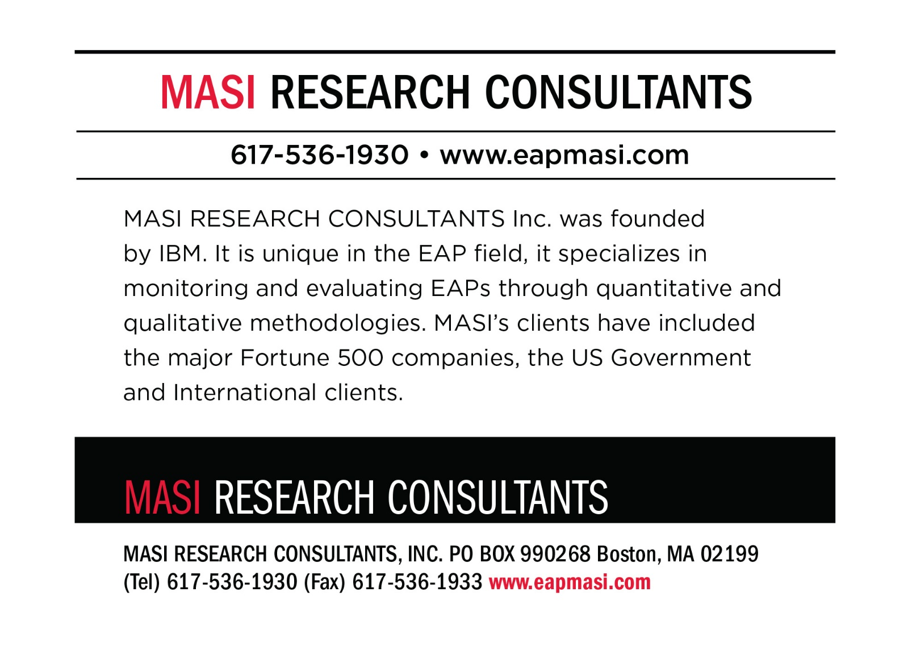
Thank you for supporting the
Social Work in the Workplace and Employee Assistance Sub-specialization!

Slide 3
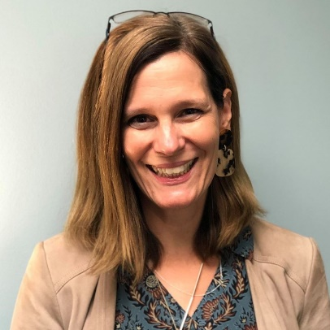
“I am using my UMSSW EAP Specialization Education by continuing to build an organization specifically for those who want to work in a well-rounded environment, all-the-while, promoting health and wellbeing to workplaces, families, and individuals.”
Janet Hosford-Lamb, MSW ’00, LCSW-C, LCSW, SAP
President and Founder
Focused Solutions LLC
UMSSW Social Work in the Workplace
& EA Alumni Spotlight:

Slide 4
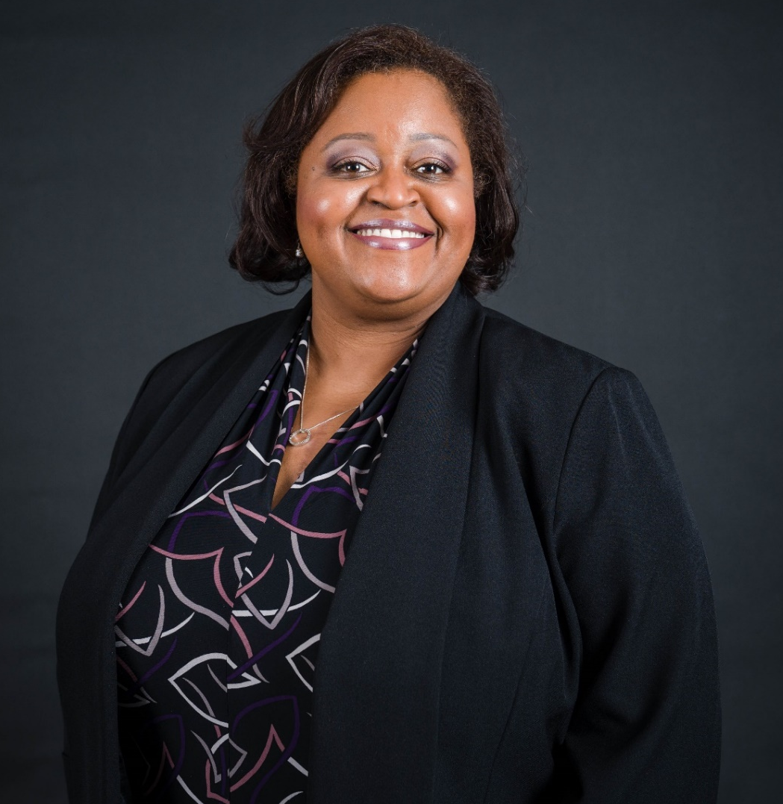
“The EAP specialization helped to prepare me for my career by focusing on workplace policy, all components of an EAP with the infamous RFP course and giving me connections for jobs and contracts. I currently have my own private practice in which I provide onsite EAP counseling at a federal agency, hold a contract with the State of Maryland to offer EAP counseling and Critical Incident Stress Debriefings (CISD) for state employees who are in danger of losing their jobs, and I also hold contracts with a number of other companies where I provide CISD and counseling for first responders, veterans and those in sensitive positions. I still have a connection with the EAP sub-specialization faculty and offer support for its graduating students. I am grateful for the opportunity provided by the program and the uniqueness of the UMSSW.”
Tanya Bryant-Nickens, MSW ‘08, LCSW-C
Trauma Therapist/EAP Counselor
Tanya Bryant-Nickens, LCSW-C - Private Practice
UMSSW Social Work in the Workplace
& EA Alumni Spotlight:

Slide 5
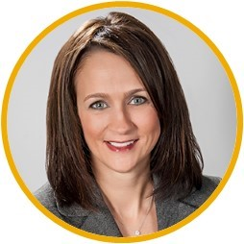
“The specialized EAP classroom training and targeted field work required during my experience at UMSSW EAP has provided me with a foundation and framework which I have modeled throughout my 20+ year career. By learning how to design an effective EAP as a successful workplace management tool, I have been able to demonstrate and train others on the critical components necessary to provide quality comprehensive, integrated EAP services rooted in high-touch service and care.
In addition, the connections I have maintained as an alumni has led to the recruitment of countless students with a substantial number of our BHS Care Coordinators and Management Consultants holding degrees from the UMSSW EAP specialization. Prospective clients place a high value on our employees who have participated in the highly renowned EAP-specific track offered through UMSSW.”
Dawn Motovidlak, MSW ‘97
President & CEO
BHS
UMSSW Social Work in the Workplace
& EA Alumni Spotlight:

Slide 6

Thank you for supporting the
Social Work in the Workplace and Employee Assistance Sub-specialization!

Slide 7
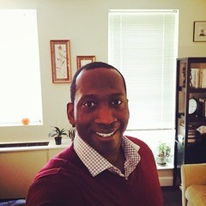
“The EAP subspecialization taught me to love work and be curious about my potential. As much as I dreaded the RFP class, it taught me how to respond to RFPs and conceptualize value for my work. I will never forget the people who taught me that and I thank you.”
Rodney Orders, MSW ’03, LCSW-C
Owner
Orders Counseling, LLC
UMSSW Social Work in the Workplace
& EA Alumni Spotlight:

Slide 8
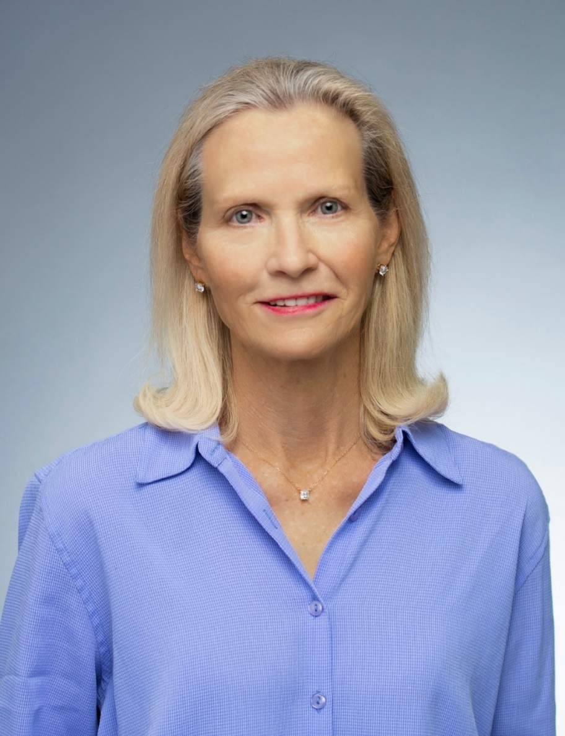
“The implementation of curriculum and field placements in Occupational Social Work (now EAP), has created generations of social workers equipped to support workplaces as an effective practice setting for the delivery of wellness and behavioral health interventions.”
Heather Healy, MSW ’84, LCSW-C, CEAP, Q-SAP, CCDC, LAP-C
Director of EAP
Association of Flight Attendants-CWA, AFL-CIO
UMSSW Social Work in the Workplace
& EA Alumni Spotlight:

Slide 9
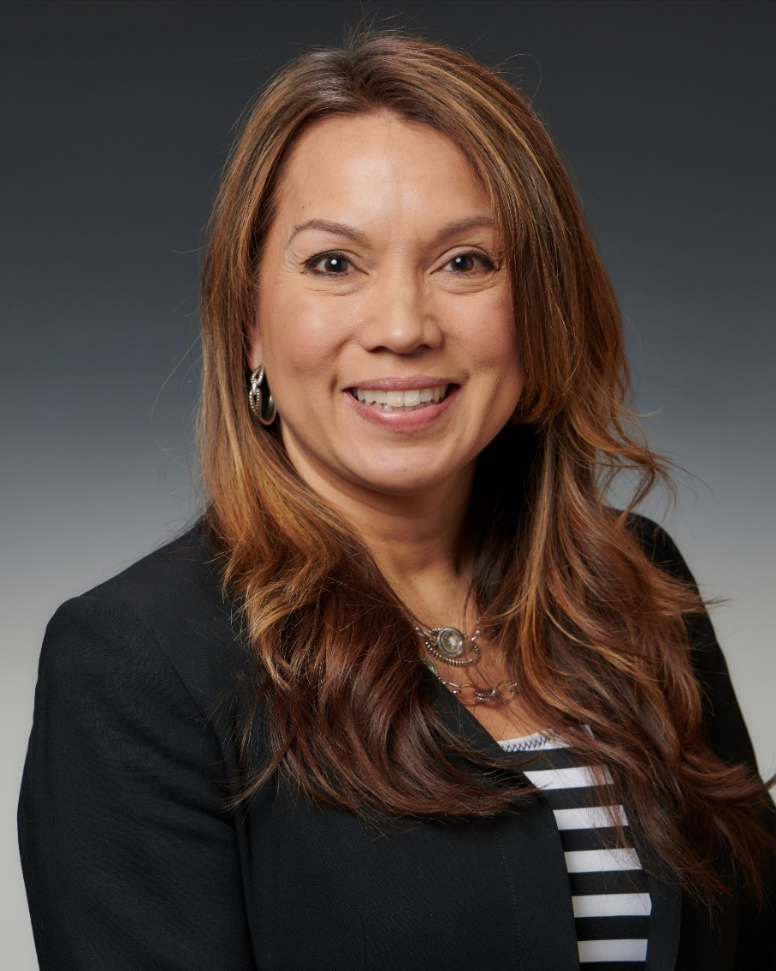
“My UMSSW education has positively impacted my career because it has opened the door to limitless possibilities to make a difference in the world. It has put me in a place where I am able to impact lives in a meaningful way, strengthening families and empowering our youth to carry on the important ideals of social work.
I truly enjoy this work. I find it so rewarding and purposeful. I am proud to be an alumna of such a prestigious school, with many wonderful professors who are doing impressive work. But what I appreciate most of all, is the way the SSW made me feel comfortable and embraced me into the family.”
Julie Huntington, MSW ’19, LMSW
Clinician
Outpatient Mental Health Clinic, The Children’s Guild, Inc.
UMSSW Social Work in the Workplace
& EA Alumni Spotlight:

Slide 10

Thank you for supporting the
Social Work in the Workplace and Employee Assistance Sub-specialization!

Slide 11
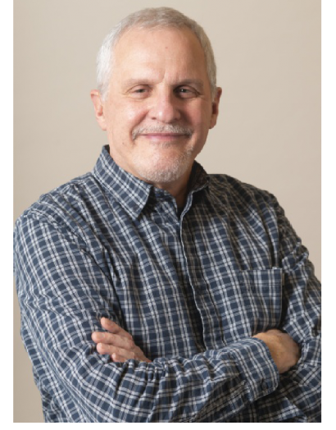
“I was one of Dale Masi’s original EAP specialization students, before she even had a formal program. Through the SSW EAP specialization I was able to learn the basics of EAP work, a field I knew nothing about and was fortunate enough to have stumbled into. I have spent the past 36 years working in the EAP field, having worked internationally (Trinidad and Tobago), as an external vendor (Sheppard Pratt EAP) and finally for the past 31 years as the Director of an internal program at the University of Maryland. Dr. Masi opened my eyes to a whole new field that has changed over the years but the basic principles I was taught back then are still applicable to this day.”
Tom Ruggieri, MSW ’84, LCSW-C
Coordinator
Faculty Staff Assistance Program (FSAP)
University of Maryland, College Park
UMSSW Social Work in the Workplace
& EA Alumni Spotlight:

Slide 12
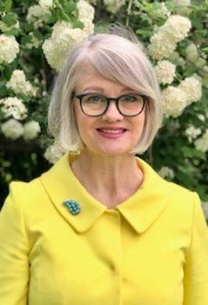
“I’ve been using what I learned in the SSW EAP program throughout my decade as a clinician and leader in Johns Hopkins’ employee assistance program. My SSW EAP education has helped me to communicate to leadership the value an embedded EAP delivers, to bring a holistic perspective to my work with individuals, teams, and leaders, and, most importantly, to nurture a team of clinicians who lift up employees and guide managers with compassion, skill, and insight.”
Frances Callahan, MSW ’10, LCSW-C
Assistant Director, Johns Hopkins mySupport
Johns Hopkins University
UMSSW Social Work in the Workplace
& EA Alumni Spotlight:

Slide 13
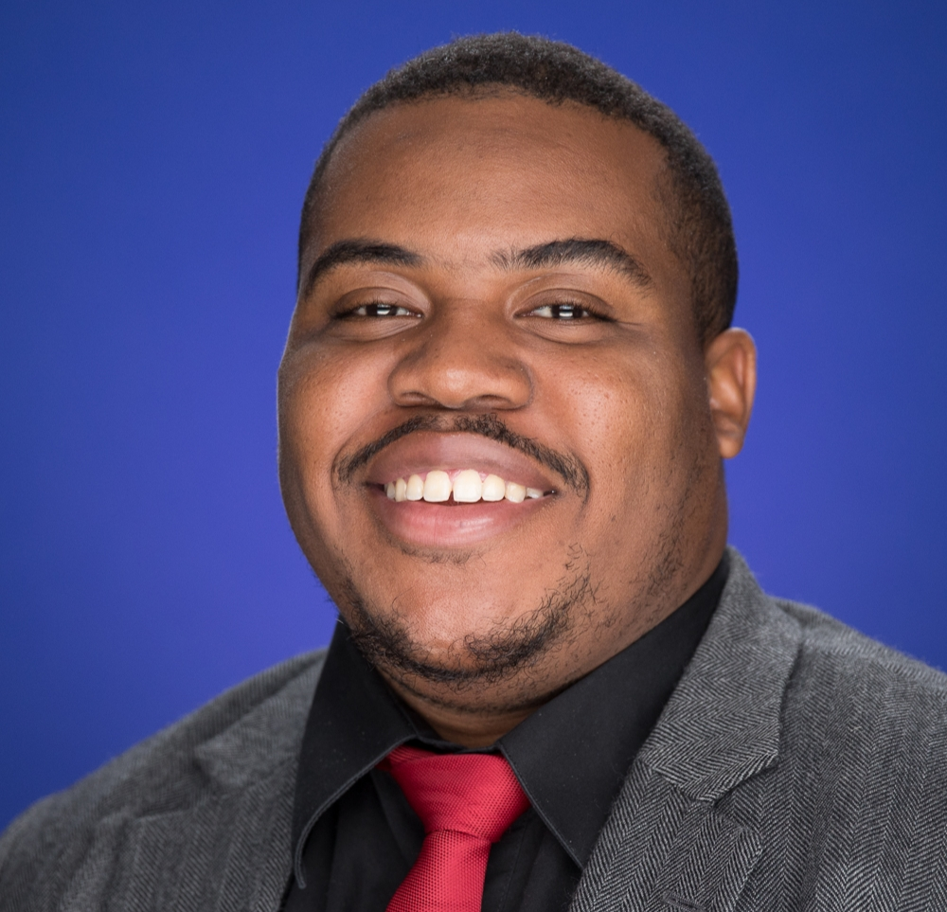
“Being in the EAP sub-specialization has really put in perspective for me the value of having flexibility within your treatment. The immense network of colleagues I received has also had a positive impact on not only my career but life in general. There were mentors that have supported me then and now. I owe a great deal to the EAP program and it changed how I view myself and the services I am able to provide in the workplace.”
Ramonte Crowder, MSW ’16, LCSW-C, SAP
EAP Clinical Associate, Washington Metropolitan Area Transit Authority
President, Dedication Counseling, LLC
UMSSW Social Work in the Workplace
& EA Alumni Spotlight:

Slide 14


Thank you for supporting the
Social Work in the Workplace and Employee Assistance Sub-specialization!

Slide 15
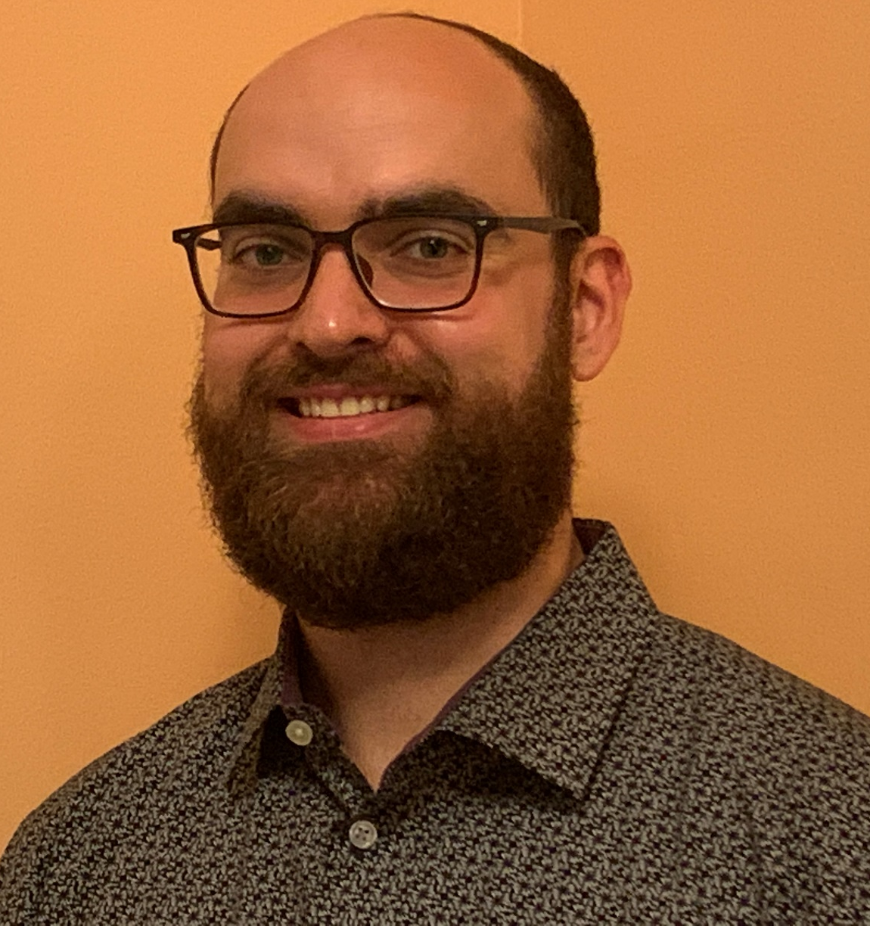
“I feel that the EAP sub-specialization at the UMSSW has truly provided me the knowledge, experience, and understanding that I need to successfully work as a social worker in the employee assistance field. The comprehensive and solid foundation that I developed through the EAP sub-specialization at the UMSSW has not only provided me the tools, skills, and confidence needed to successfully navigate a wide range of essential areas of the employee assistance field with ease, but has increased my passion and drive to both work in and contribute to this valuable field.”
Micah Saviet, MSW ’20
Clinical Care Coordinator
BHS
UMSSW Social Work in the Workplace
& EA Alumni Spotlight:

Slide 16
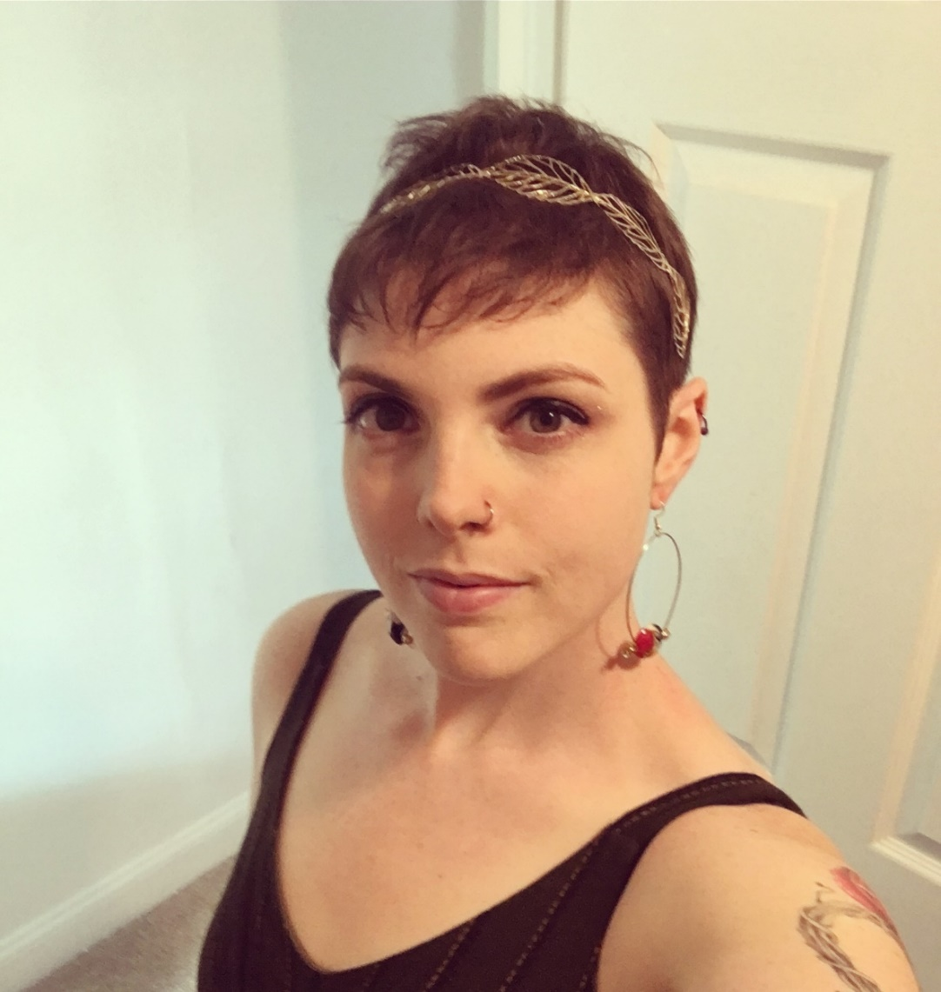
“Being in the EAP sub-specialization at UMBSSW has provided me with an in-depth understanding of how the workplace is the perfect place to address people's concerns and how by changing the workplace you can affect change in more lives than you could ever imagine. I learned that I want to work in this space to enact change and aid the adults who do not know that they have services to help them in there REAL problems. I am so excited to be working in this space and can not wait to see what I can do.”
Maggie Glass, MSW ’20
Care Concierge
Guide and Thrive (subset of BHS)
UMSSW Social Work in the Workplace
& EA Alumni Spotlight:

Slide 17
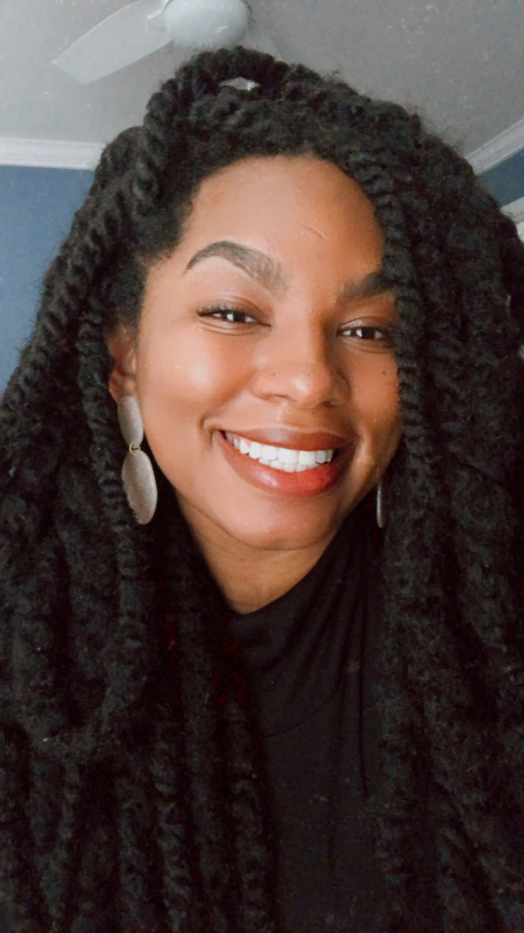
“My SSW EAP education has assisted me in my current role as an EAP Associate with NIH. I hope to continue to use that education to facilitate necessary conversations in the workplace about race, privilege and mental health to create better workplace environments for black and brown employees.”
Jehlisa Hillocks, MSW ’19, LMSW
EAP Associate
National Institutes of Health
UMSSW Social Work in the Workplace
& EA Alumni Spotlight:

Slide 18
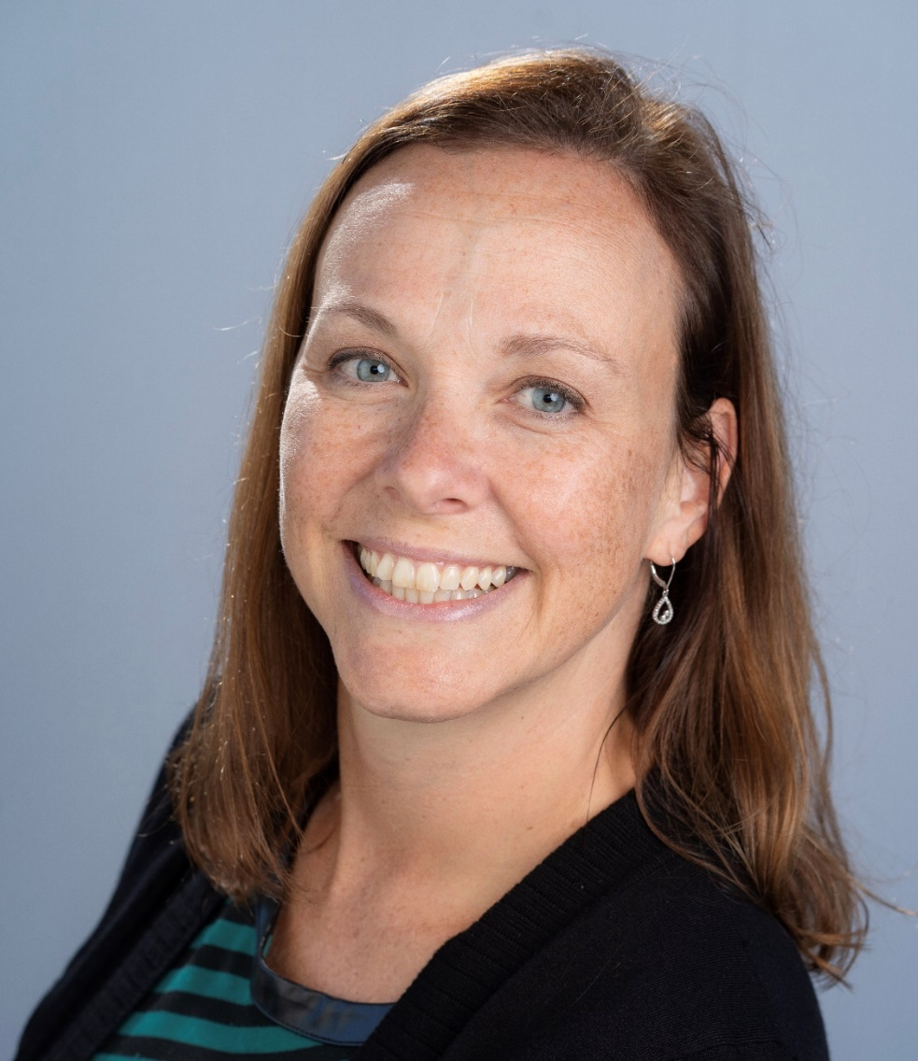
“I am using my MSW/EAP Education to help make the lives of our Cracker Barrel employees and their family members better at work and home. I am not only their counselor and coach but I also help shape their benefits plans, manage relocations and go out to our restaurants to provide Critical incident Support when robberies or things like natural disasters occur. I am so grateful for the education I received at UMB as it has help me grow as an EA Professional with so many transferable skills right at a time when my company needs a social work the most!”
Karen Franklin, MSW ‘99, LCSW, CEAP
Senior Manager, EAP & Relocation Services
Cracker Barrel Old Country Store
UMSSW Social Work in the Workplace
& EA Alumni Spotlight:

Slide 19
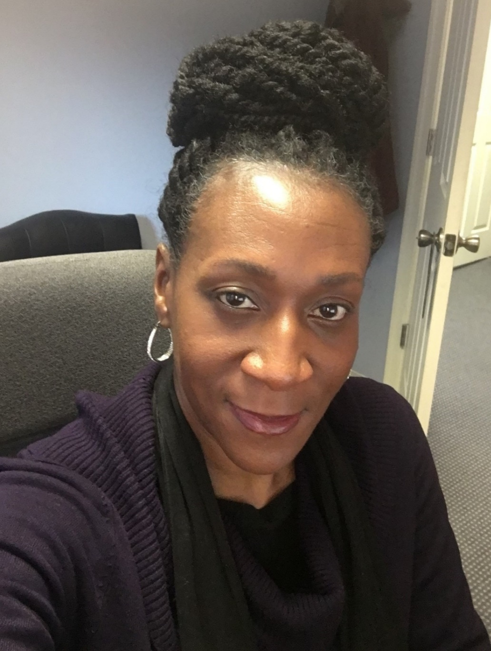
“I felt very fortunate to have found my current position through the UMSSW EAP alumni network. As a result of the supervision and experience gained at my EAP internship, I was better prepared to meet the needs of our unique client population.”
Astrid Richardson-Ashley, MSW ‘17, LCSW-C
Senior Clinical Manager
Maryland Physician Health & Professional Rehabilitation Programs
Center for a Healthy Maryland
UMSSW Social Work in the Workplace
& EA Alumni Spotlight:

Slide 20
“I have absolutely brought the EAP philosophy to this position - particularly in terms of learning my population, their particular stressors and concerns, and by forming strong relationships with all key personnel throughout the commands with which I work.”
Laurie Hanley, MSW ’94, LCSW-C
Counseling and Advocacy Supervisor
U.S. Department of the Navy
UMSSW Social Work in the Workplace
& EA Alumni Spotlight:

Slide 21
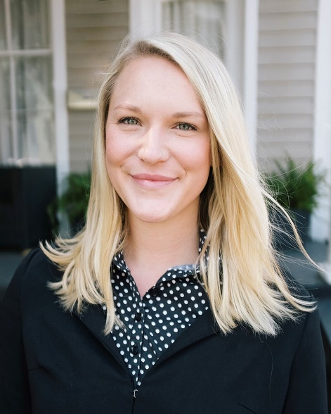
“The UMSSW EAP sub-specialization has opened up so many diverse opportunities for me in the short time I've been practicing since graduating in 2018. I'm grateful to have been able to work for the internal EAP with the Washington Metropolitan Area Transit Authority serving bus and train operators and am now working with physicians in Colorado through the Peer Assistance Program to help ensure their health and wellness which has been especially rewarding work as we navigate the current medical pandemic.”
Emma Frauenfelder, MSW ‘18, LSW
Clinician
Colorado Physician Health Program
UMSSW Social Work in the Workplace
& EA Alumni Spotlight:

Slide 22
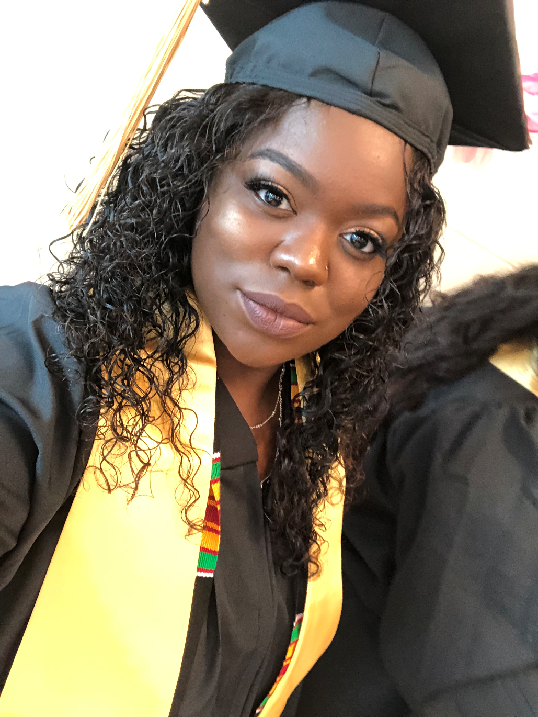
“UMSSW EAP sub-specialization helped mold me to be a well-versed social worker – that is, skilled in assessing the clinical and administrative needs not only of my current and former clients but also of the organizations, projects, and policies I have worked with. Through the EAP sub-specialization, I obtained valuable transferable skills in non-profit, private practice, and corporate workplaces.
Since my time in the EAP program, I have helped flight attendants enhance their union EAP program; assisted clients in understanding Americans with Disabilities Act policies; written grants for federal funding, and helped manage a project to increase the accessibility of public transportation for individuals who are blind or low vision.”
Zoraida Younger, MSW ’19, LMSW
Clinical Social Worker
University of Maryland Medical Center
UMSSW Social Work in the Workplace
& EA Alumni Spotlight:

Slide 23
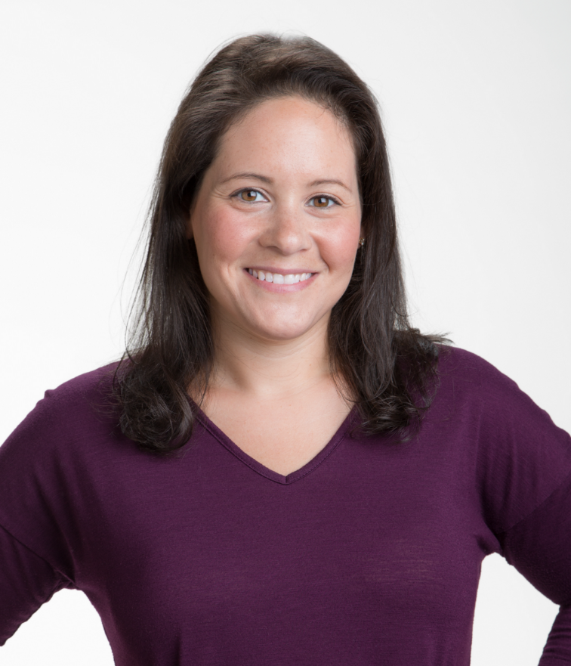
“My SSW EAP education has benefited me in my new career in numerous ways. I have found the additional training on substance use disorders helpful as I create a substance abuse group for trauma patients on my unit. Education on CISM helped prepare me for working in a hospital, and especially now when there is increased stress on staff due to the pandemic. I am grateful for the additional education and workplace perspective I received from the EAP track, and expect it to serve me well throughout my career.”
Jenna Adler, MSW ’19, LMSW
Social Worker
Sheppard Pratt Trauma Disorders Unit
UMSSW Social Work in the Workplace
& EA Alumni Spotlight:

Slide 24
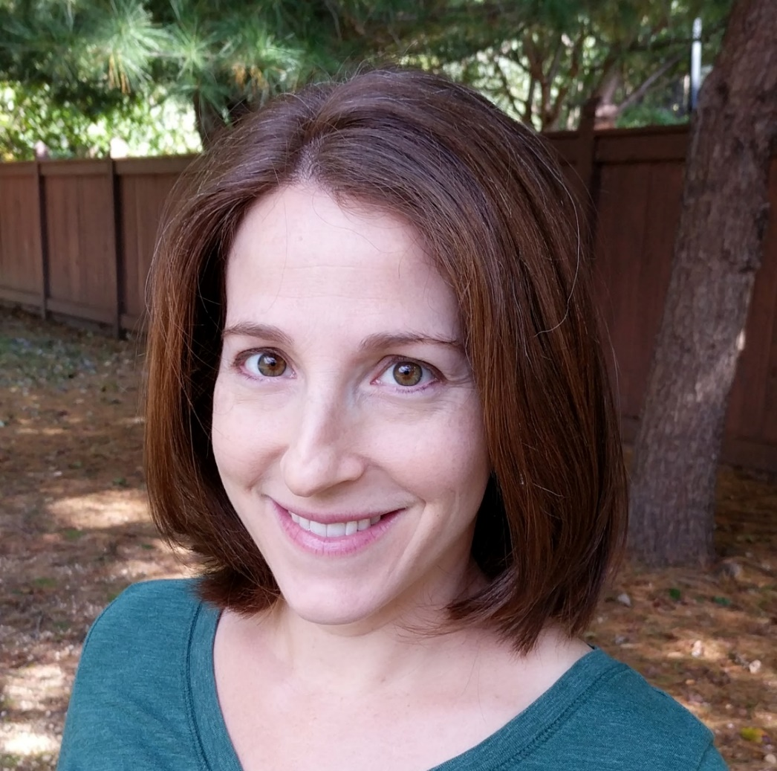
“As a direct result of my EAP Sub-Specialization, I have been very involved in EAPA which helped me network within the community and create lasting connections which helped me in my career. I had a wonderful EAP internship that taught me what I needed to know to get started working directly with clients in a therapeutic setting. After my EAP education, I was able to grow a thriving private practice, with a large part of our work being EAP clients. I have been able to help the community during difficult times through critical incident responses that all started with my EAP experience in school and lead to additional crisis response training. I am forever thankful for the EAP Sub-Specialization, as it has significantly positively impacted my career and life!”
Amy Hooper, MSW ’08, LCSW-C, CEAP
Director
Gaithersburg Counseling Center
UMSSW Social Work in the Workplace
& EA Alumni Spotlight:

Slide 25
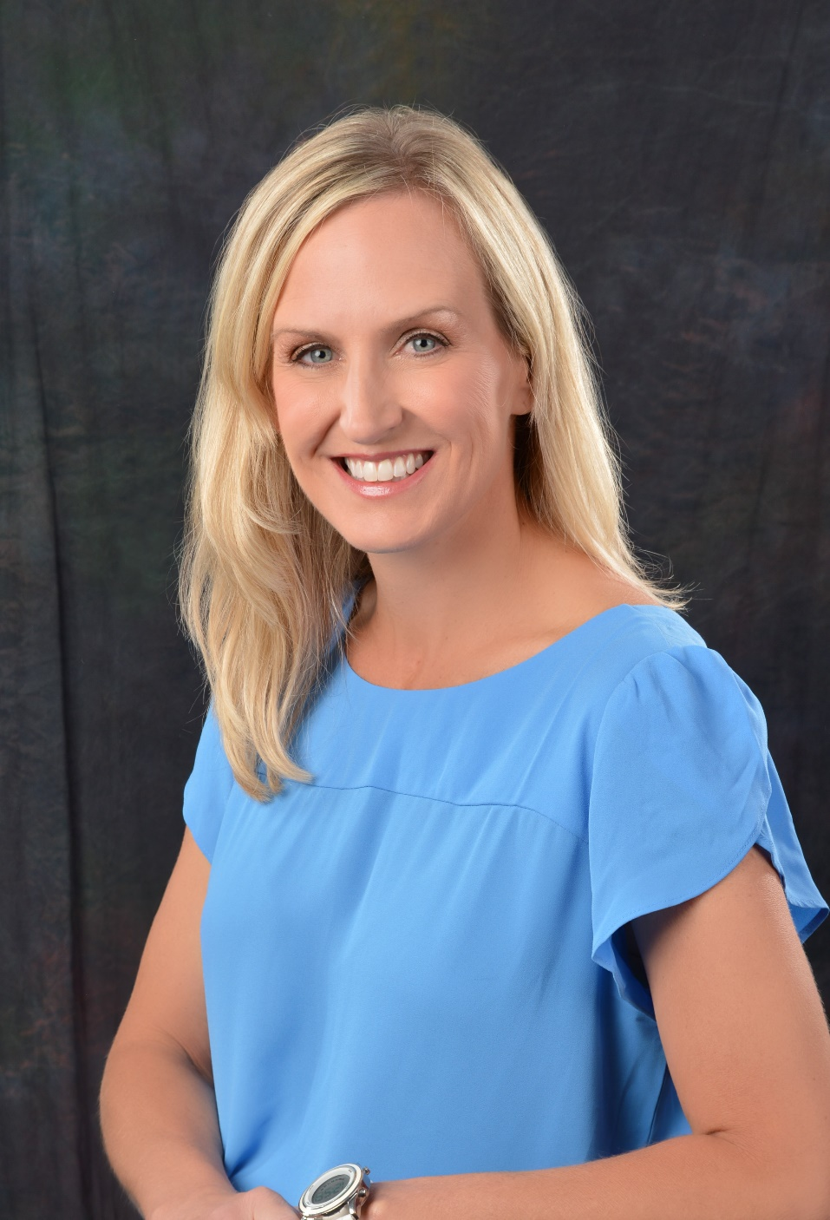
“My SSW EAP education paved the way for me to have a seat at the table as an influencer in critical decisions that impact the behavioral health and well-being of workers as well as the health of the workplace culture. It led to experiences of advocating for policy, programs and services that indeed have changed the lives of workers and shines a light on social justice efforts that are needed at work.”
Michelle Carlstrom, MSW ’96, LCSW-C, CTM, BCC
Adjunct Faculty, UMSSW
Principal & Executive Coach, Build a Better Culture
UMSSW Social Work in the Workplace
& EA Alumni Spotlight:

