Slide 1
Managing Change:
Making the Most out of Change
March 28, 2018
Bob Norton, CEAP, LPC

Slide 2
NIST Employee Assistance Program
Bob Norton
301-975-5129 101/C33
Services
Free
Confidential Short Term
Counseling and
Consultation for all who work at
NIST and their immediate family
members.
Short term counseling, consultation,
assessment and referral on work related
and personal concerns
Management Consultation
Training
Grief Counseling and Trauma Response
Stress management
Family/Marital
Emotional
Elder Care and other dependent care
issues
Alcohol and Drug counseling/assessment
Legal/Financial resources
Training
Communication
Change Management
Anger Management
Conflict Resolution
Stress Management
Myers-Briggs Training
Working with Difficult People
Humor in the Workplace
Workplace Violence Prevention
Civility in the Workplace
Hallmarks
Confidentiality
Informed consent
Written Release to disclose
Security
Voluntary

Slide 3
Managing Change
15% of the workforce is eager to accept it
15% of the workforce is dead set against it
70% is sitting on the fence, waiting to see what happens
6% Propose change
7% Buy-in quickly
32% Join in after some success
42% Join in after risk is zero
13% Continue to oppose

Slide 4
Objectives
Learn the difference between change and transition
Learn about the developmental model of transition (Ending, Neutral Zone, New Beginnings
Understand the potential of the “Neutral Zone”
Understand the impact of change/transition
  Self/family/management/organization
Learn about useful tools to navigate the emotional side of transition in adapting to change
Learn useful coping tools in managing transitions

Slide 5
Managing Change
What is change?
  Change is an event expected or unexpected. It takes place in a particular point in time. Something stops and something new happens
What is transition?
  Transition is the gradual psychological process through which individuals/groups reorient/adjust to a new situation. Transition cannot be localized in time.

Slide 6

Change Can Be Perceived As Positive or Negative
  Getting a Job After Graduating From College
  Getting Married
  Divorce
  Having a Child
  Child Leaving for College
  Child getting married
  Getting a new job
  Losing a Job
  Death of a Parent
  Reorganization

Slide 7
Activity
Reflect on a major change in your life:
1. As you made this change in your life, what ended?
security, turf, status, influence, memberships, meaningful work, identity, control, relationships, etc.
2. How did that make you feel?
angry, scared, lonely, excited, relieved, wondering
3. What helped (or might have helped) to make the transition easier?
(talk to someone, time, information, knowing others were going through the same thing, ) What did you learn to avoid in the future?
What kind of outcome did you have? What helped create a good outcome?
What would you do differently to avoid a bad outcome?
Notes:
This activity should be done individually, first. Then people can share with a partner. Then, last, individuals can share with the whole group. Use the last question to help the group develop a plan to help themselves through the change and transition.
Ask team members:
“Let’s first look at your own experience with change. Reflect on a major change you’ve made in your life:
Ex: Change in stages of life…recent grad (first job; leaving home)…middle of career….end of career…new baby…new house…new workplace

Slide 8
Stages of Transition
Begins with an Ending
Has a Neutral Zone
Has a New Beginning

Slide 9
Three Phases of Transition
*People transition at different paces
ENDINGS
NEUTRAL
ZONE
NEW
BEGINNINGS
Not yet
begun
Finished
Time
Notes:
People in an organization may be experiencing all three phases at the same time because people will go through the stages at their own rate.
Some people may Not yet be in transition – they haven’t heard about the change; or just don’t have time to think about it; They’ll say things like it’s “No big deal... Just another idea...Oh, that.”
Letting Go is the first phase of transition. It’s when we recognize what is ending and how we feel about it. What do we need to let go of? Our initial reaction may be Shock, confusion, denial, loss of identity, anger, exploration, acceptance. We may say “This is a crazy idea...You mean I won’t be able to do that any more?...I just won’t do it” “Where do we get the time to take on these new roles, additional responsibilities?
The Neutral Zone is the limbo between the old and the new; it can feel chaotic; many times deadlines are missed; you discover old ways of doing things aren’t working; people are struggling to figure out where things are; A lot of support is needed during this phases. We may say: “Why did we ever think we could do this...we missed another deadline...it’s scary, no one really knows what’s going on...it’s hard to get up in the morning”
This is a time for temporary processes or decisions “this is what we’ll do for today (or this week) and we’ll address it at our weekly meeting.”; try new things; if old ways don’t work well, do what makes sense; have temporary solutions, i.e. CVC hotline for 24-7 questions and answers
The New Beginning is the tentative acceptance of the new situation; the day you look forward to when coming to work feels like you’ve always worked there. You might say “Oh, I get it...I can see some new ways to make this system work...it isn’t half bad...”
Those who are finished with the transition will find all this is old news and something else is new on the horizons
People may say “I can’t say I love my new job, but I can live with it...It took me a while to get used to the new team but I like it now..”

Slide 10
Managing Change
Begins with an Ending
  Shock/Denial/Disbelief/Minimization
  Defensive retreat/Anger/Rage/Fear
  Resistance
  Acknowledgement
  Acceptance/Integration

Slide 11
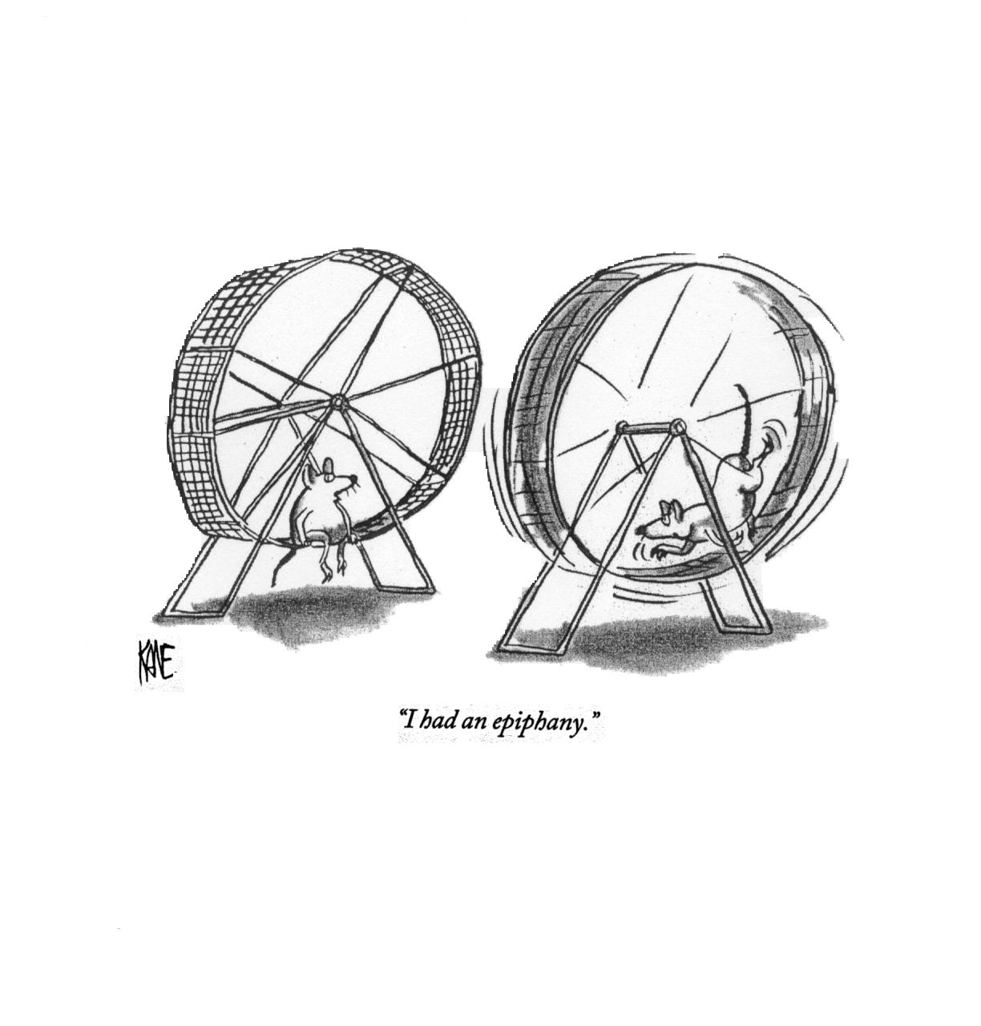

Slide 12
Letting Go Strategies
How to “Let go”
Accept reality of subjective losses
Don’t be surprised at overreaction (normal)
Acknowledge the losses openly
Expect signs of loss/mark the endings
Give and request clear information (again and again and again)
Treat the past with respect
  It was the past that got you here
Embrace risk taking, innovation, and learning from experiences/mistakes
Know your resources
  “He who lacks the time to mourn lacks the time to heal.”
  “Every exit is an entry to somewhere else.”

Slide 13
Managing Change
Factors in Organizational Change
  People (They are essential change agents)
  Resistance is a natural and inevitable reaction in an organization. You can expect it
  Resistance is sometimes hidden, so it may be necessary to take active steps to find it
  There are many reasons for resistance; it is important to understand it
  We manage resistance by working with people, and helping them deal with their concerns
  There are many ways to build acceptance. It is important to be flexible. But persist!

Slide 14
Resistance to Change
Why people resist change:
  Defense mechanism caused by frustration and anxiety
  A potential loss of status, pay, comfort, or power that arises from expertise
  A fear of the unknown future and about their ability to adapt to it, e.g. fear that one will not be able to develop new skills and behaviors that are required in a new work setting
  Resentment in employees due to a perceived unfairness of the change
  Possible violation of "personal agreements" management has with their employees. This can involve elements of mutual trust, loyalty and commitment and go very deep
  An employee may be operating on the basis of a desire to protect what they feel is in the best interests of the organization
  An employee may provoke insightful and well-intended debate, criticism, or disagreement in order to produce better understanding as well as additional options and solutions

Slide 15
Managing Change
Resistance to Change
  The take-home message: there is no simple explanation for Resistance to Change, and therefore no simple way to circumvent it.
  There are instances where an employees “resistance”, although not in the plan, could result in beneficial consequences

Slide 16
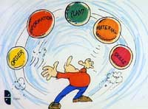

Managing Change
The Neutral Zone

Slide 17
Managing Change
“Neutral Zone”
Loss of focus
Confusion
People leaving
Uncertainty (what next?)
Ambiguity
Lack of communication
Loss of trust
Rumors run rampant
Stress increases
Lack of direction
Decrease in productivity
Fertile void (for good or bad)

Slide 18
Managing Change
Where to start: The 4 “Ps”
Purpose
  Make the case…explain the rationale in straight forward terms
  Adults want an honest explanation
Picture
  What will it look like (helps with explanation)
  What’s in it for them (helps with engagement)
Plan
  Involve employees in the planning (seek expertise)
Participation
    Involve all the stakeholders
      Relationships (Build or Re-build both ways)
William Bridges
Managing Transitions

Slide 19
Managing Change
New Beginnings (Reorganization of Behavior)
New Vision
New Plans
New Energy

Slide 20
Managing Change
Progress with “New Beginnings”
Endorse New Beginnings by:
  “Walking the walk”: be consistent
  Be aware of quick successes
  Symbolize the new identity
  Celebrate the success (large and small)
  Embrace the setbacks as opportunities
  Communicate, Communicate, Communicate (to and from management)
  Listen, Listen, Listen

Slide 21
Impact on Managers
Perspective
Managers deal with the stress of change
  Unknowns…loss…worry…
Managers have to lead and guide employees through transition (energy consuming)
Managers (also employees) need to be aware of the impact and upheaval change can have on employees
Managers need to be present (available). MBWA

Slide 22

What Does it Take?
Communication
Knowing what you want
    Being Proactive
Knowing your audience
Being open & honest
Communication
Remaining focused
    Being flexible
Communication

Slide 23
What You Can Do
Acknowledge change
Acknowledge feelings
Accept feelings
  Seek support
  Allow time to grieve the loss
Designate “worry time”
Communicate (obtain accurate, factual information)
Stay Positive
Learn about transition
Be flexible
  Attitude of learning
Participate (input/plan)
Manage stress
  Exercise/relaxation/diet
Increase your value
Keep working
Measure and celebrate success

Slide 24
Managing Change
How to Relieve/Manage your Stress
Recall useful past experiences
Control responses
Be proactive/Stay engaged!
Stay informed
Take care of yourself
Recognize needs and ask for help
  Talk it out
Practice stress management
Exercise
Good nutrition
Avoid complainers
Seek out optimists
Avoid isolating
Save or Make time for leisure activities
CONSIDER OPTIONS
  NETWORK
  Update resume
Career transition assistance
Remember the value of Humor
Resources

Slide 25

Breath and Compose

Slide 26
Best Practices
Sr. leadership plays vital role (be present)
Over-communication is impossible during change
Planning begins with getting the right people together
Information not normally required for day-day ops is critical during change
Development of a transition plan from all sides
  Enlists stakeholders participation
I.D. of business processes no longer needed in future is vital to success
Goal setting strategies
Provision of career transition
Monitoring and recognizing progress (Quick wins)

Slide 27
Consequences of not Managing Change
Lower productivity
Passive resistance
Active resistance
Turnover of valued employees
Disinterest in the current or future state
Arguing about the need for change
More sick days
Change not fully implemented
People finding work arounds
People revert to the old way of doing things
The change being totally scrapped
Divides are created between ‘us’ and ‘them’

Slide 28
Summary
Change is an event followed by transition…a process of adjustment involving letting go, a neutral zone and embracing new beginnings.
Transition to change is influenced by attitudes, beliefs and experiences and has an emotional impact on those affected.
The Neutral Zone there is great potential for both positive and negative paths.
Continuous communication of facts is imperative in successful navigation of change events.
Employment of stress management (exercise, diet, sleep, social contacts) can enhance transition process.

Slide 29
Soooo…Depending on your outlook;
Change can be:
  Painful
  Threatening
  Uncertain
  Necessary
  Beyond control
  Unfair
  OR……………….
Change can also be:
  Opportunistic
  Exciting
  Rewarding
  Challenging
  Healthy
  Hopeful

Slide 30


Slide 31


